Slide 1
“IoT-Based Smart Traffic Light Controller”
Your Name: Roger Miller
Course Name: CEIS114: Introduction to Programming for IoT
Date: 29 July 2024

Slide 2
Project Overview
Purpose: The objective of this project is to design and implement an IoT-based smart traffic light controller using the ESP32 microcontroller. The project simulates a real-world traffic light system, integrating multiple traffic lights, a crosswalk, an emergency buzzer, and an LCD display to demonstrate the power and flexibility of IoT technologies.
Key Components:
  ESP32 Microcontroller
  Traffic Lights (Red, Yellow, Green LEDs)
  Push Button for Crosswalk
  LCD Display for status messages
  Emergency Buzzer
  IoT Integration for remote control and monitoring

Slide 3
Challenges
Content: Hardware Integration: Aligning the various components (LEDs, LCD, buzzer) on the breadboard was challenging due to space constraints. This was resolved by meticulously planning the layout and using a larger breadboard.
Programming Logic: Developing the code logic to manage multiple traffic lights and integrate the crosswalk and buzzer functionalities was complex. This was overcome by breaking down the problem into smaller, manageable tasks and testing each part individually before integrating them.
Debugging Errors: Encountered issues with code errors and circuit malfunctions, which were resolved through systematic troubleshooting, consulting documentation, and utilizing online resources.

Slide 4
Career Skills
Programming Proficiency: Enhanced my skills in C++ programming, specifically in developing and debugging code for IoT devices.
IoT System Design: Gained hands-on experience in designing and implementing an IoT system, which is directly applicable to careers in IoT development and smart technology fields.
Problem-Solving: Improved my ability to identify, analyze, and solve complex problems, a skill crucial for any technical career.
Project Management: Learned to manage a project from start to finish, ensuring all components are completed on time and integrated seamlessly.

Slide 5
CEIS 114
Module 2
Project Plan for IoT Traffic Controller

Slide 6
Rubric – Due at the end of Week 2
Activity | Requirement(s)
ESP32 installed and powered ON | Screenshot of circuit
WiFi Scan | Screenshot of Serial Monitor

Slide 7
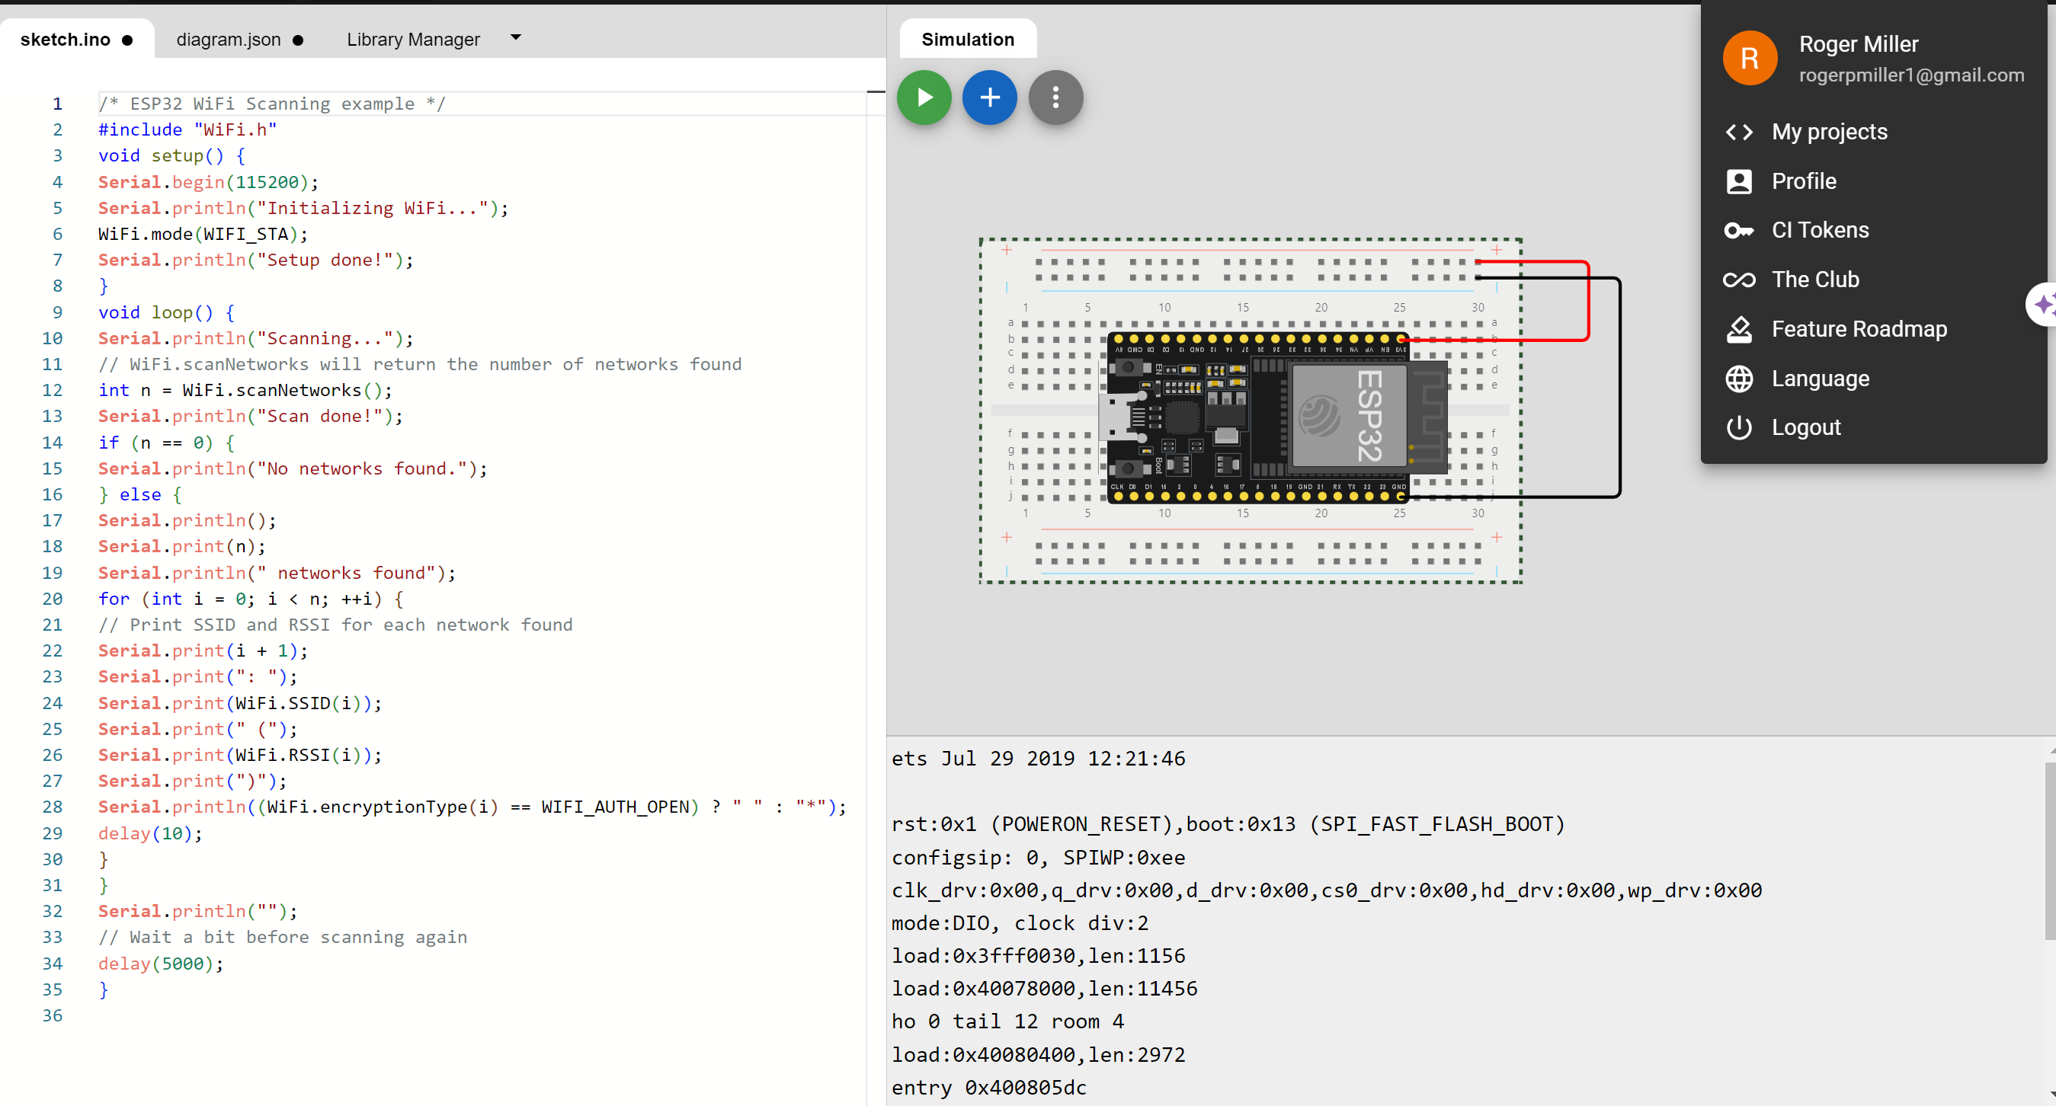
ESP32 (Screenshot)
Microcontroller mounted and powered ON

Slide 8
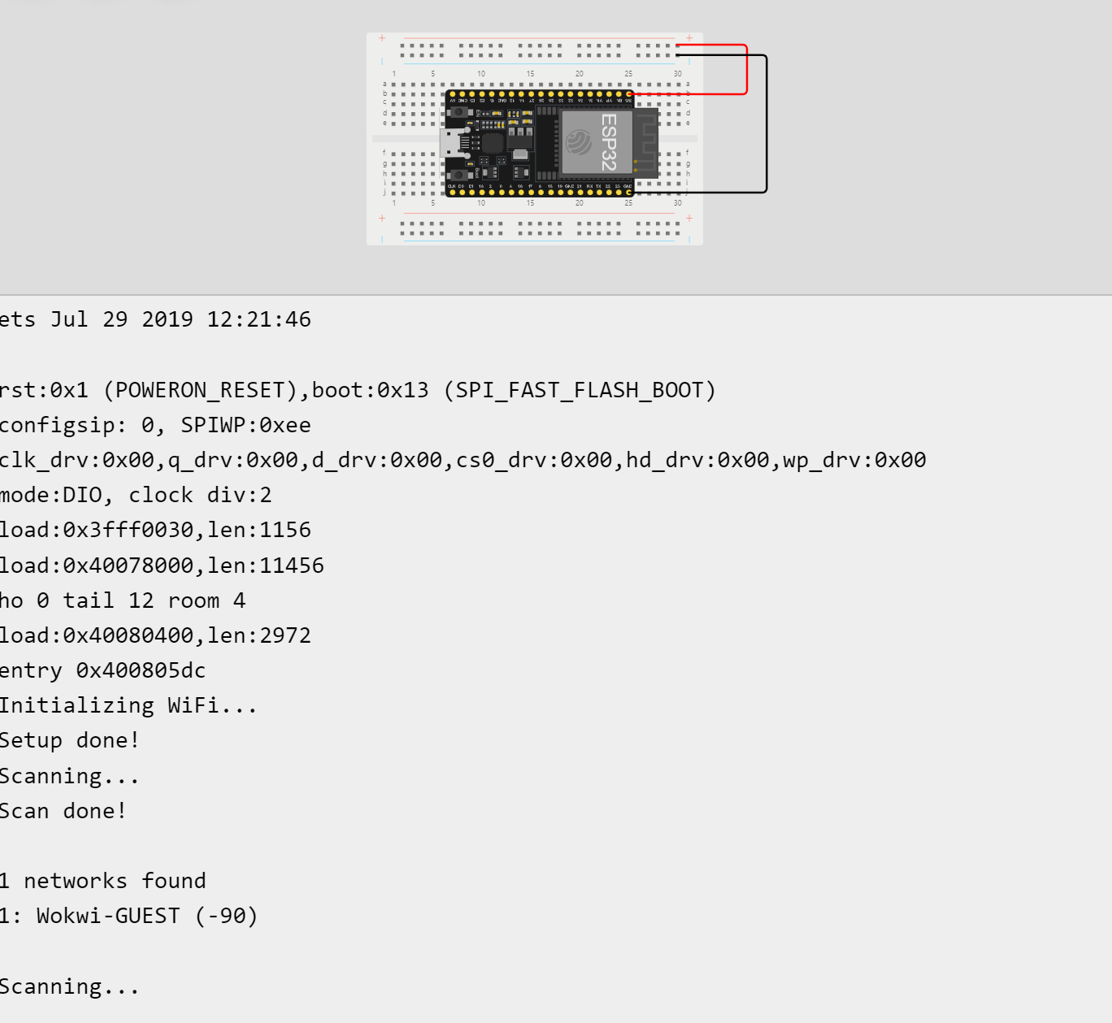
ESP32 WiFi Scan
Screenshot of Serial Monitor showing the available networks

Slide 9
CEIS 114
Module 3
Creating the Traffic Controller

Slide 10
Rubric
Activity | Requirement(s)
Include a screenshot of your circuit | Picture of the breadboard with LEDs ON.
Screenshot of code showing your name in comment | Screenshot of code in the Code Editor showing your name in one of the comments.

Slide 11
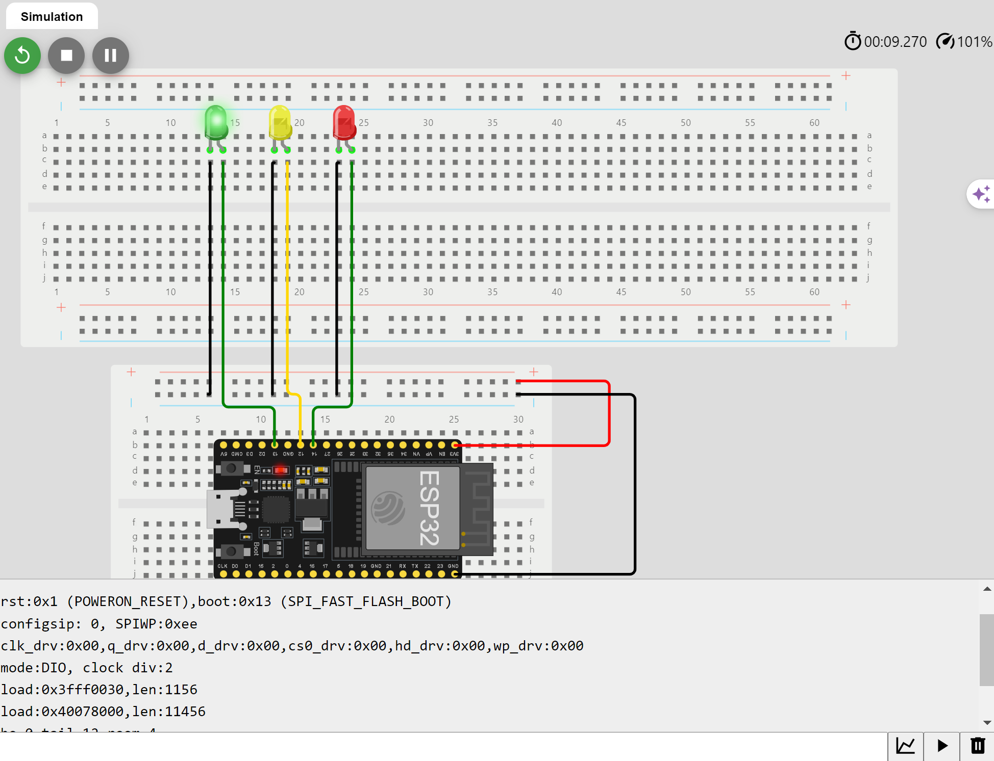
Picture of circuit with working LEDs
ESP 32 Board
Colored LEDs: Red, Yellow and Green
Wires
Breadboard

Slide 12
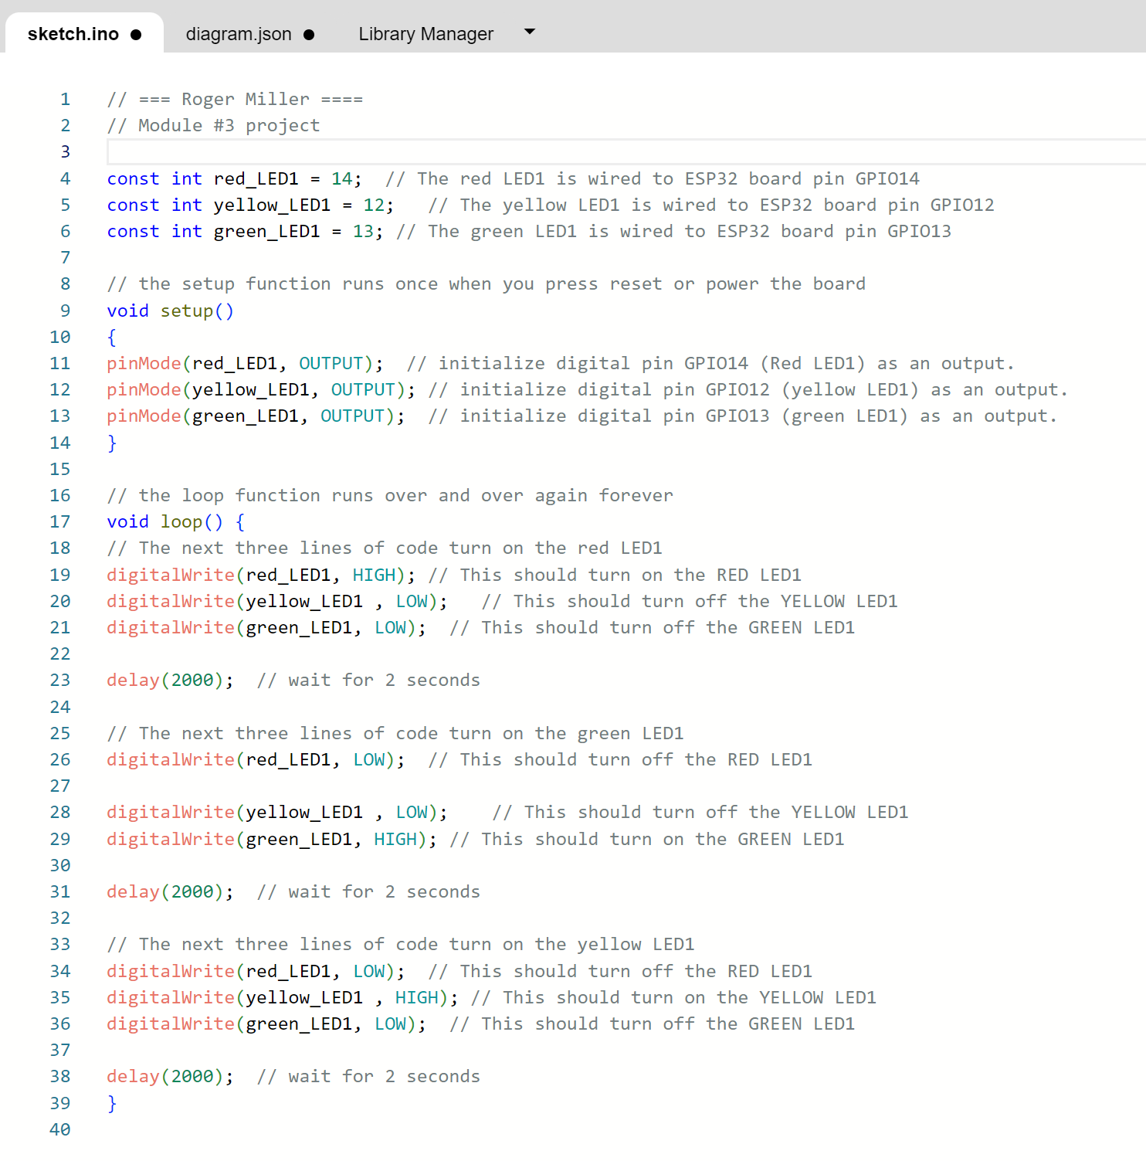
Screenshot of code in the Code Editor
Screenshot of code in the Wokwi Code Editor

Slide 13
CEIS 114
Module 4
Creating a Multiple Traffic Light Controller

Slide 14
Rubric
Activity | Requirement(s)
Include a screenshot of your circuit | Screenshot of the breadboard with LEDs ON.
Screenshot of code showing your name in comment | Screenshot of code in the Code Editor showing your name in one of the comments

Slide 15
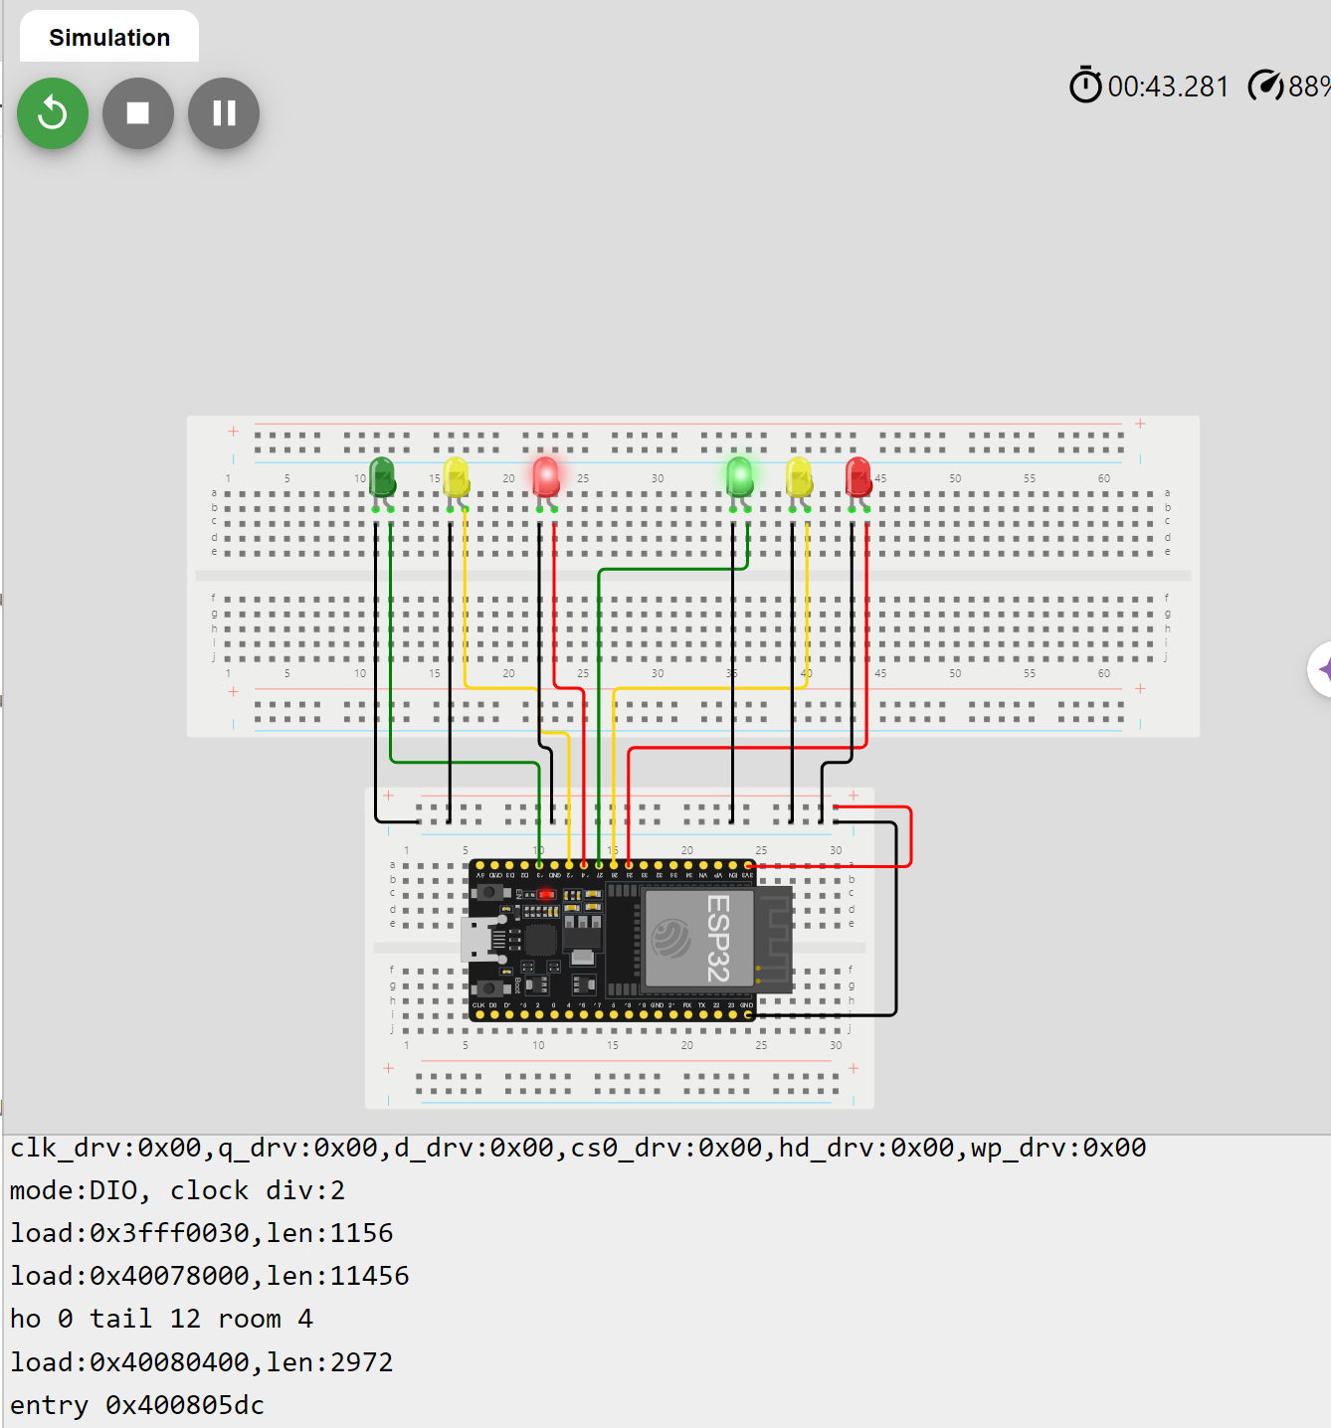
Picture of circuit with working LEDs
ESP 32 Board
Colored LEDs: Red, Yellow and Green (two sets)
Wires
Breadboard

Slide 16
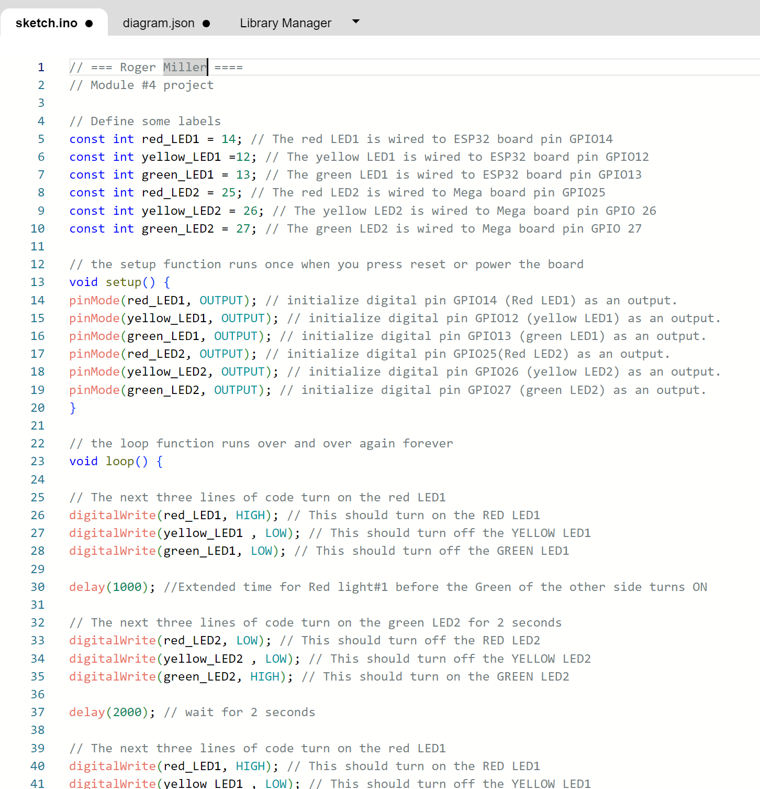
Screenshot of code in Wokwi
Screenshot of code Wokwi Code Editor

Slide 17
CEIS 114
Module 5
Creating a Multiple Traffic Light Controller with a Cross Walk

Slide 18
Rubric
Activity | Requirement(s)
Include a picture of your circuit | Picture of the breadboard with LEDs ON
Screenshot of code showing your name in comment | Screenshot of code in Wokwi showing your name in one of the comments
Screenshot of output in Serial Monitor | Screenshot of Serial Monitor from Wokwi

Slide 19
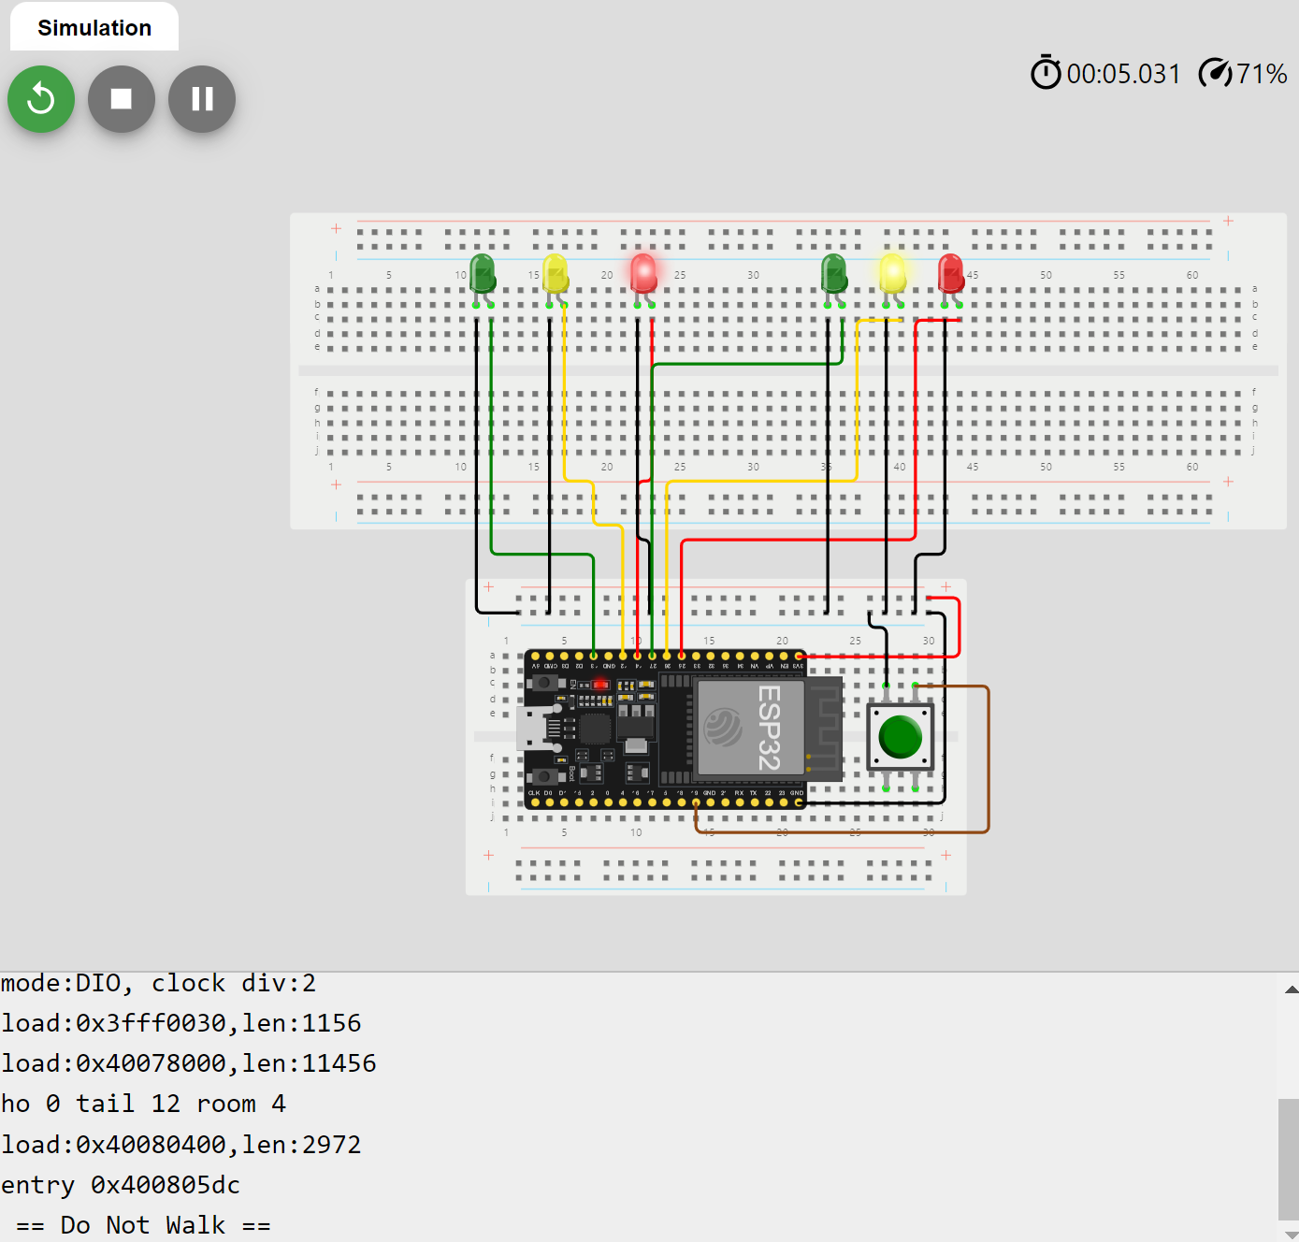
Screenshot of circuit with working LEDs
ESP 32 Board
Colored LEDs: Red, Yellow and Green (two sets)
220 Ohm Resistors (optional)
Push Button
Wires
Breadboard

Slide 20
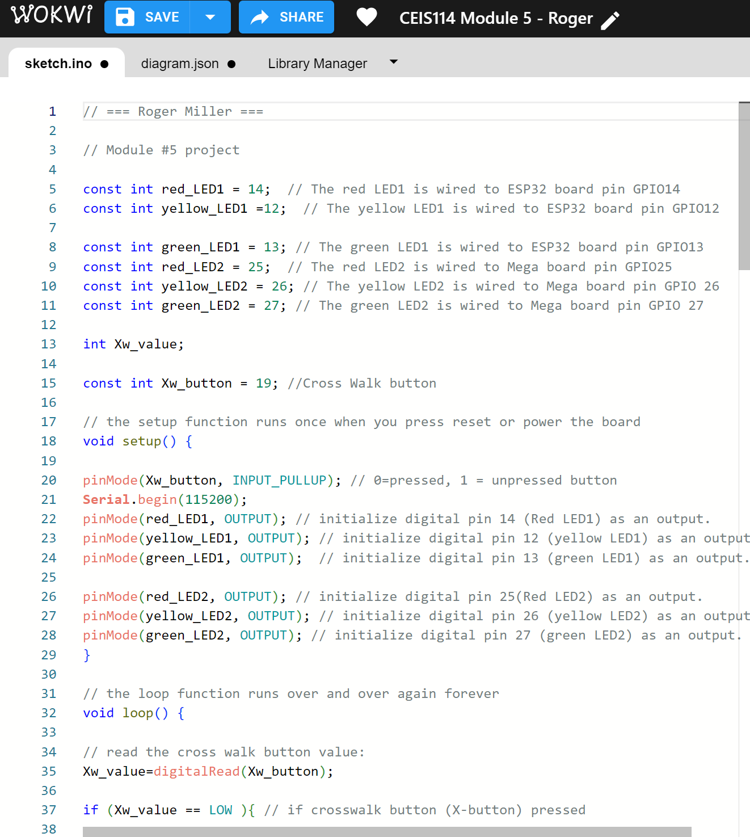
Screenshot of code in Wokwi
Screenshot of code in Wokwi Code Editor

Slide 21
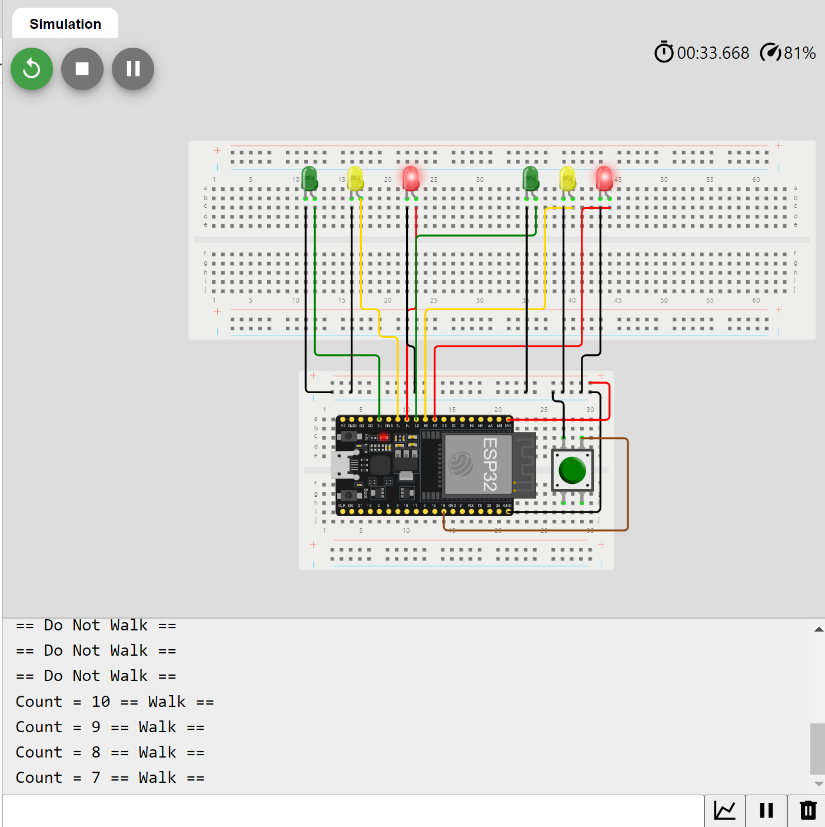
Screenshot of Serial Monitor in Wokwi
Screenshot of output in Serial Monitor

Slide 22
CEIS 114
Module 6
Creating a Multiple Traffic Light Controller with a Cross Walk and an Emergency Buzzer

Slide 23
Rubric – Due at the end of Week 6
Activity | Requirement(s)
Include a picture of your circuit | Picture of the breadboard with LEDs ON and LCD displaying message.
Screenshot of code showing your name in comment | Screenshot of code showing your name in one of the comments
Screenshot of output in Serial Monitor | Screenshot of Serial Monitor

Slide 24
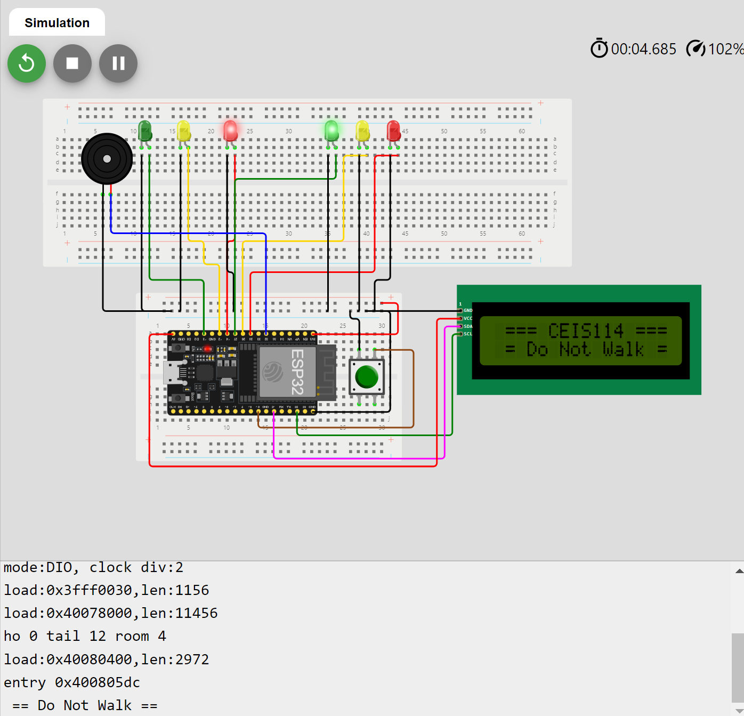
Picture of circuit with working LEDs and LCD display
ESP 32 Board
Colored LEDs: Red, Yellow and Green (two sets)
220 Ohm Resistors (optional)
Push Button
LCD Unit with Message Display
Wires
Breadboard

Slide 25
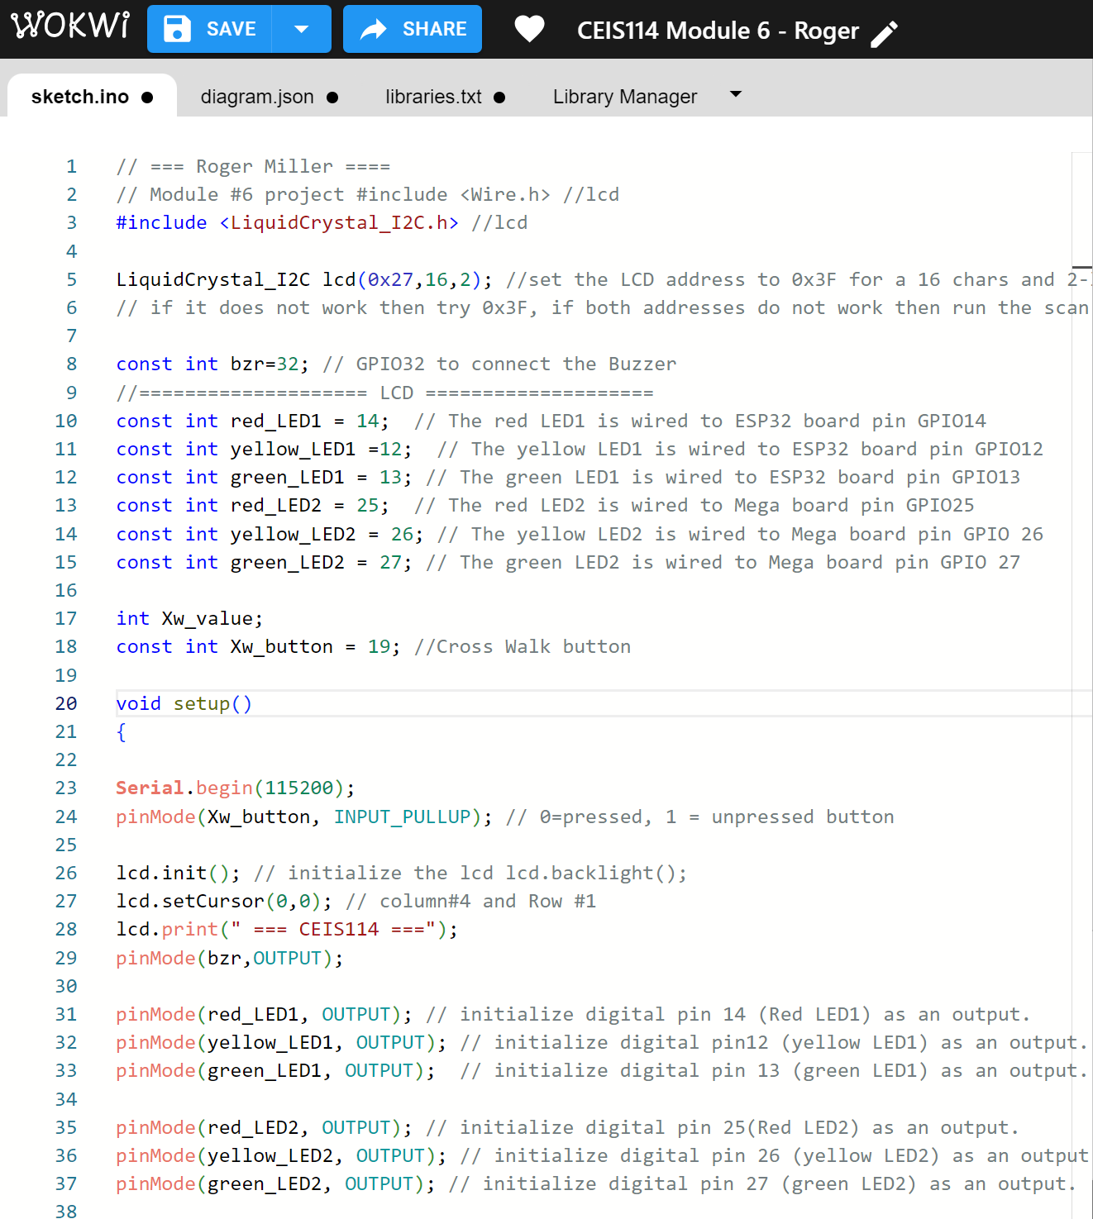
Screenshot of code in Code Editor
Screenshot of code in Code Editor

Slide 26
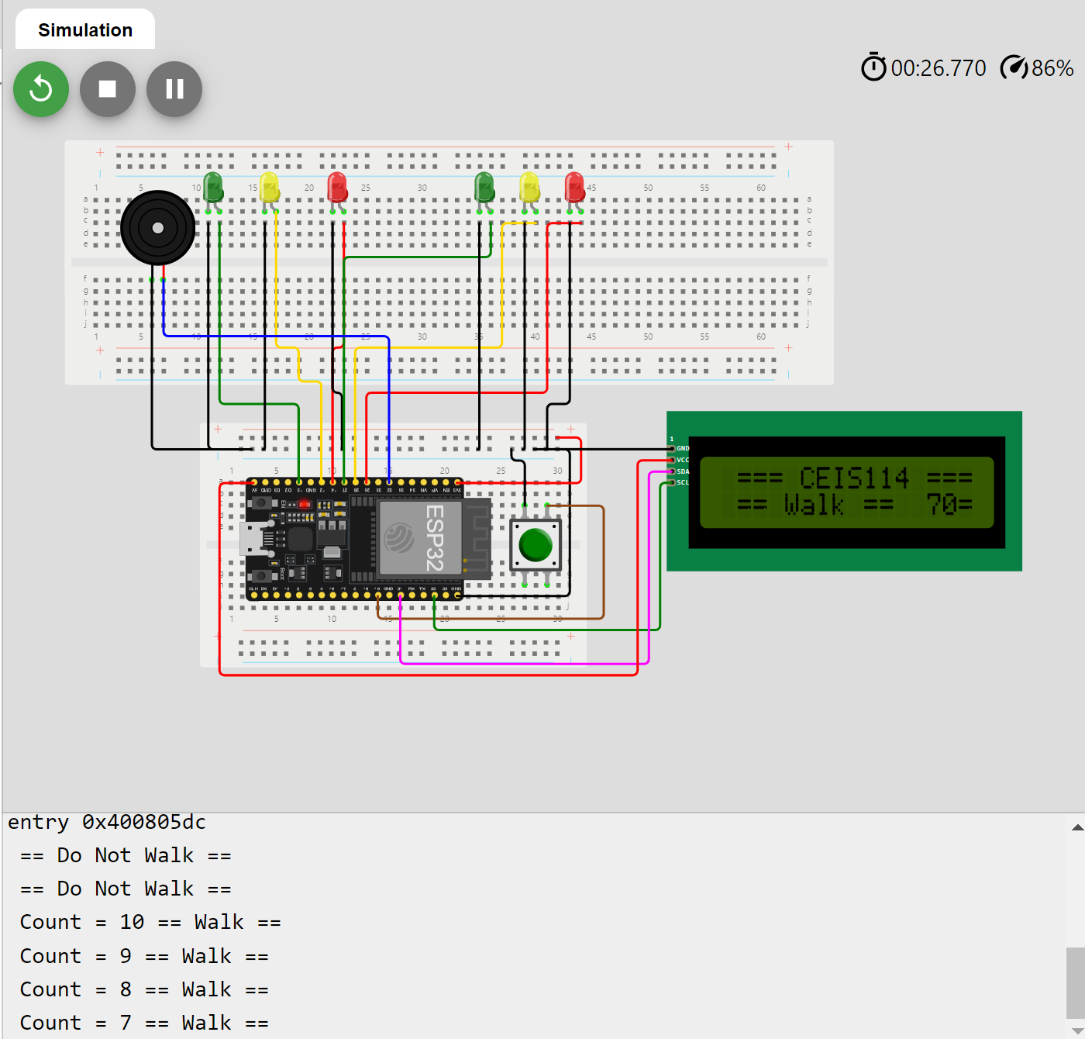
Screenshot of Serial Monitor
Screenshot of output in Serial Monitor

Slide 27
Conclusion
Project Summary: This project involved creating a smart traffic light controller that demonstrates the application of IoT technologies in real-world scenarios. The integration of multiple components like traffic lights, crosswalk, buzzer, and LCD display showcases the versatility and potential of IoT systems.
Key Learnings: I learned how to work with IoT devices, develop code for microcontrollers, and troubleshoot hardware and software issues. This experience has broadened my understanding of IoT applications and their relevance in modern technology.
Relevance to Career: The skills and knowledge gained from this project are directly applicable to a career in IoT development, smart city infrastructure, and related technology fields. This project has solidified my interest in pursuing a career in IoT and further developing my expertise in this area.

Slide 28
References
CEIS114 Weekly team live sessions

