Slide 1
Fundamentals of Infrastructure Security
Final Project Presentation
Roger Miller
SEC290

Slide 2
Introduction
Overview of the project:
- Explore cybersecurity fundamentals
- Configure and secure IT systems
- Analyze and mitigate threats

Slide 3
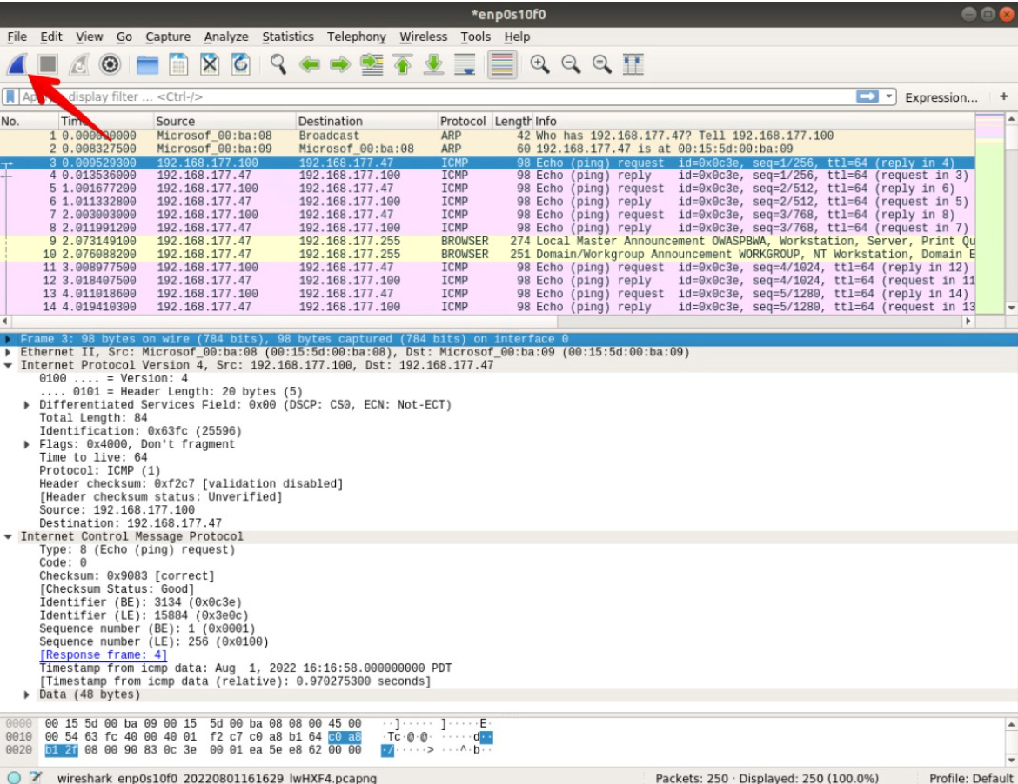
Module 2 - Intrusion Analysis
Activity: Intrusion detection using Wireshark
Key Findings:
- Differences in ICMP traffic TTL and data size
- Identified suspicious flag settings
- Screenshots: ICMP traffic analysis

Slide 4
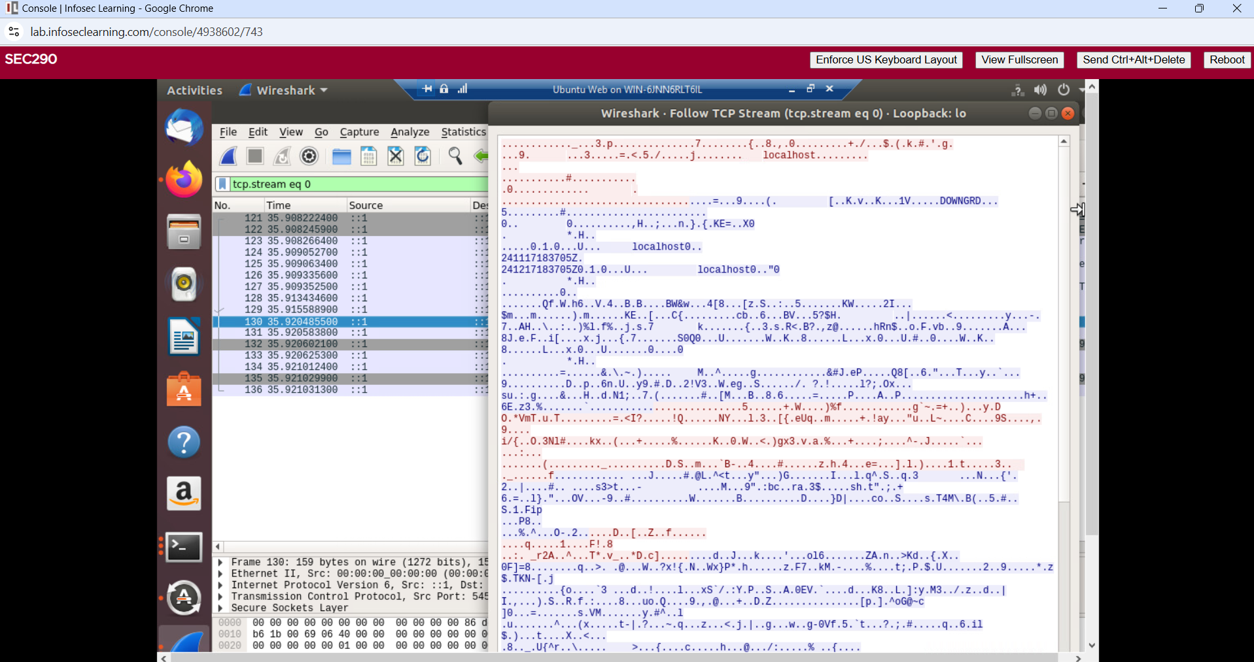
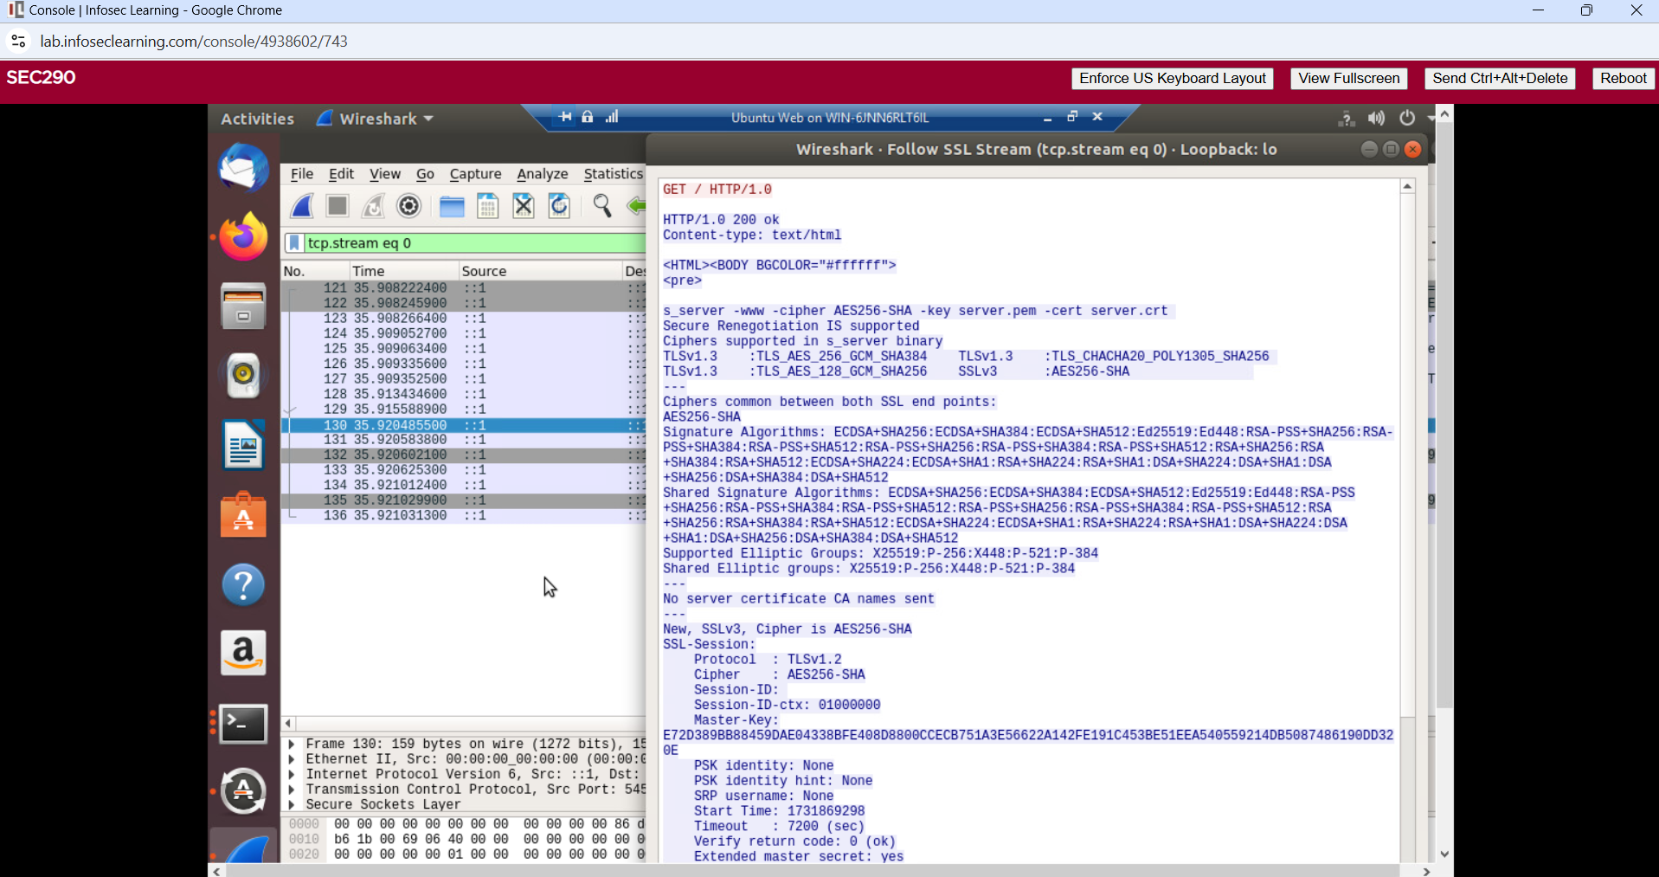
Module 3 - OpenSSL
Activity: SSL/TLS encryption and decryption
Key Findings:
- SSL/TLS file creation and decryption successful
- Screenshots: Decrypted SSL stream
Encrypted
Decrypted

Slide 5
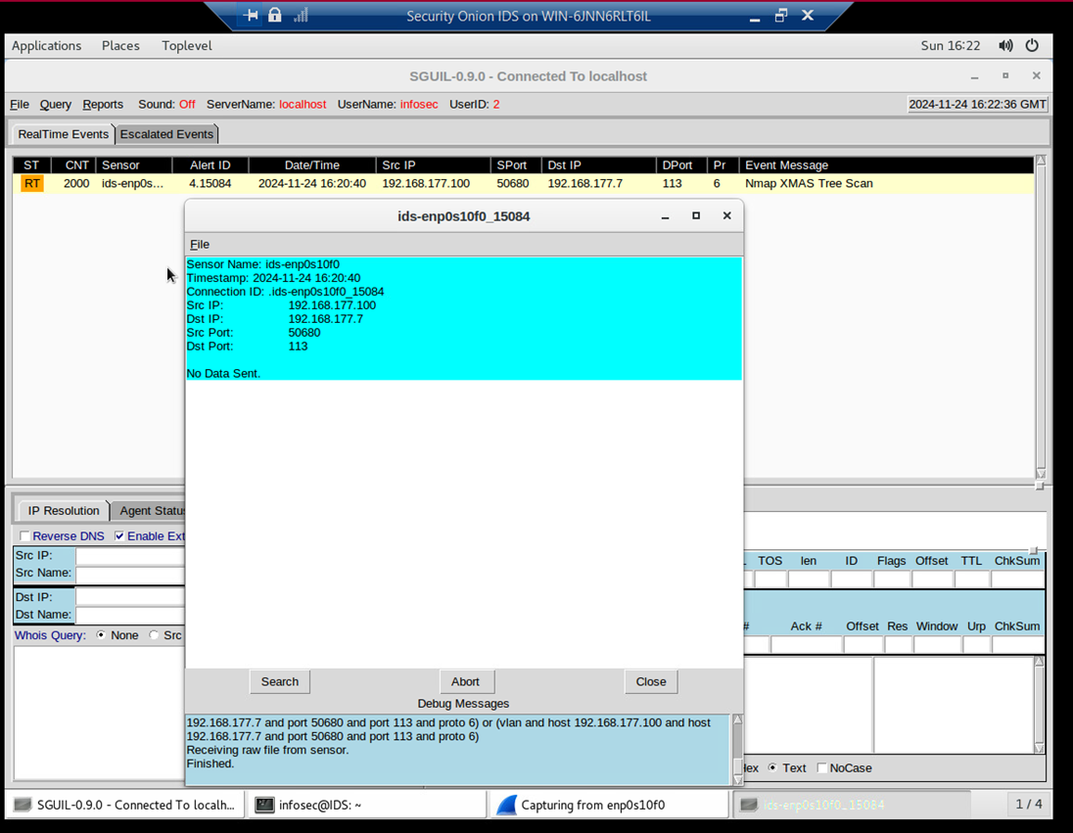
Module 4 - Snort
Activity: Snort rules testing and creation
Key Findings:
- XMAS scan alerts detected
- Custom ping activity alert rules created
- Screenshots: XMAS scan alert

Slide 6
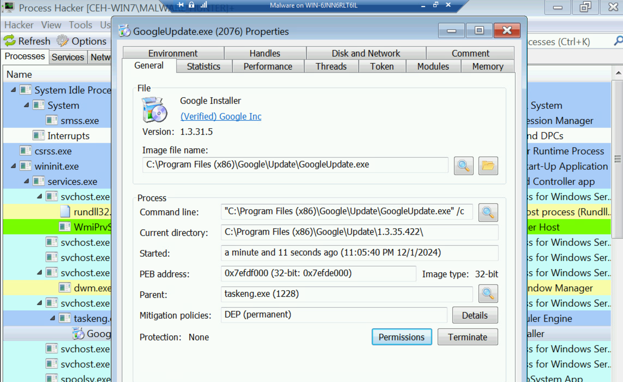
Module 5 - Live Memory Analysis
Activity: Process monitoring and analysis
Key Findings:
- Identified open ports and suspicious processes
- Analyzed process details using Process Monitor
- Screenshots: Process Hacker analysis

Slide 7
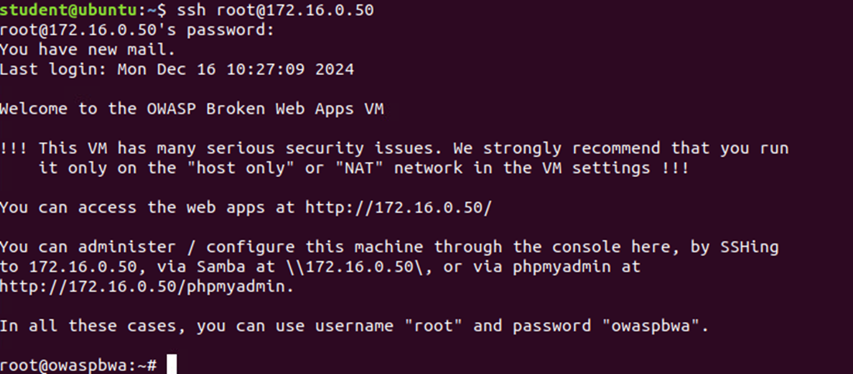
Module 6 - Firewall Configuration
Activity: Firewall settings and testing
Key Findings:
- Time-based access rules implemented
- Dynamic NAT and SSH brute-force protection configured
- Screenshots: Firewall rule output

Slide 8
Challenges
Challenges faced during the project:
- Initial setup complexities
- Interpreting intrusion data
- Ensuring rule effectiveness

Slide 9
Career Skills Gained
Skills developed:
- Proficiency in threat detection and mitigation
- Expertise in firewall and intrusion prevention
- Knowledge in cryptography and secure communications
- Application of real-world cybersecurity solutions

Slide 10
Conclusion
Summary of the project:
- Comprehensive understanding of cybersecurity
- Hands-on experience with real tools
- Preparedness for career advancement in cybersecurity

Slide 11
References
Resources used:
- Module guides
- Project videos
- DeVry University resources

