Slide 1
CEIS106 Course Project
Fundamentals of Linux in a Virtualized Environment
By: Roger Miller
May 2024

Slide 2
Introduction Slide
Overall Project: The project aimed to provide hands-on experience in navigating the Linux operating system in a virtualized environment.
Objective: Understand and implement various Linux OS components and tasks to build a foundation for future IT career.
Tools Used: Linux OS, Virtualization technologies, CLI, GUI.

Slide 3
Course Project
Operating Systems
Module 2 Linux Filesystem Hierarchy

Slide 4
Rubric
Activity
Navigate the Linux filesystem tree
Create directories and files
Copy and remove directories and files
Locate directories and files

Slide 5
Navigate the Linux filesystem tree
1. What is the pwd command an acronym for? What about the cd command?
Answer here:
pwd - print working directory. Shows the path for the current directory
cd - change directory. Change over to the directory that you specify
2. Explain the differences between a relative path and an absolute/full path in Linux.
Answer here:
Relative path – path based on your current location
Absolute path – path starting from the very top of the filesystem, which is the root -- /

Slide 6
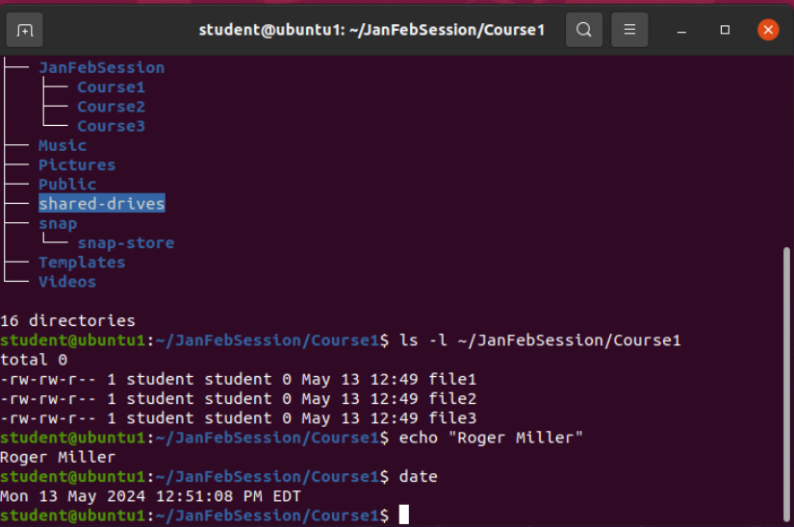
Create directories and files

Slide 7
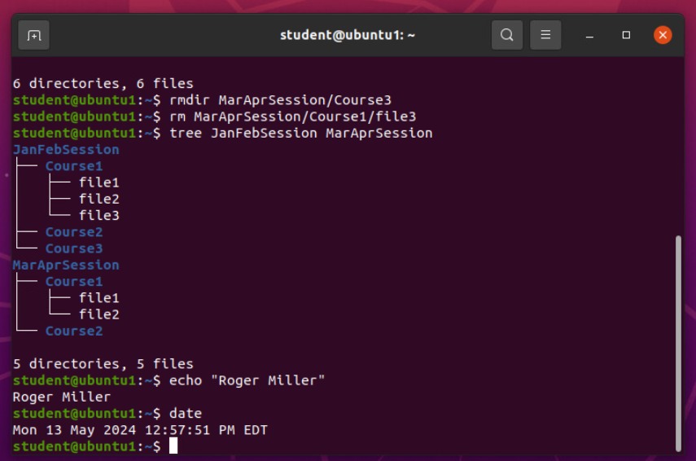
Copy and remove directories and files

Slide 8
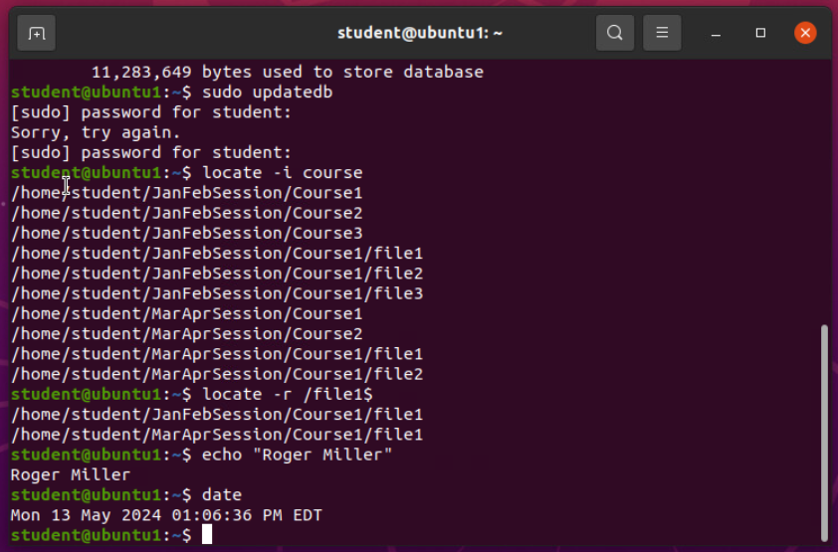
Locate directories and files

Slide 9
Course Project
Operating Systems
Module 3 Linux Shell Scripts

Slide 10
Rubric
Activity
Create a shell script
Change script file permissions
Set the PATH variable
Make the PATH variable permanent

Slide 11
Create a shell script
1. What are the file permissions of the script?
Answer here:
rw- rw- r-- --read/write for the owner, read/write for the group, read only for everyone else
2. What’s the name of the user-defined variable in the script?
Answer here:
text
3. Which redirection meta-character is used in the script? What does it do?
Answer here:
>> -- redirection to the file and appends to the end of the file

Slide 12
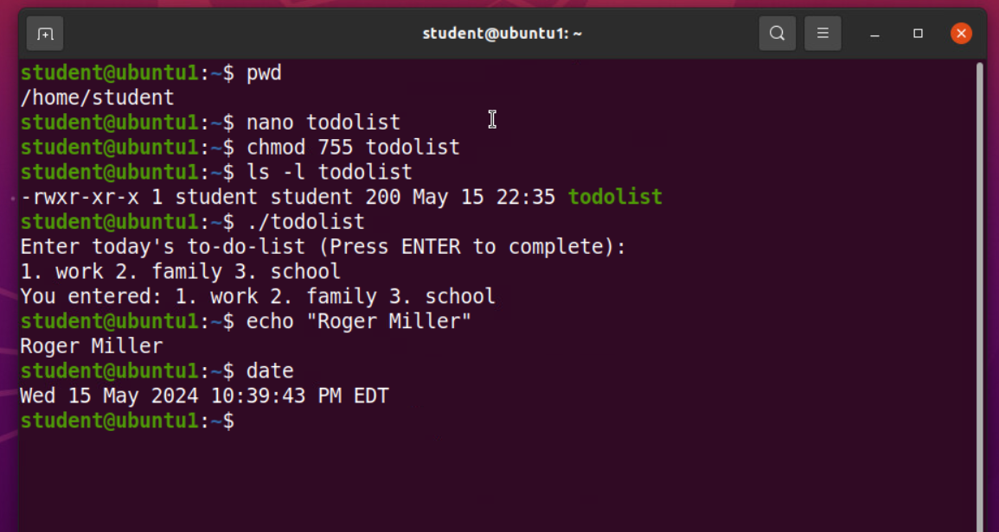
Change script file permissions

Slide 13
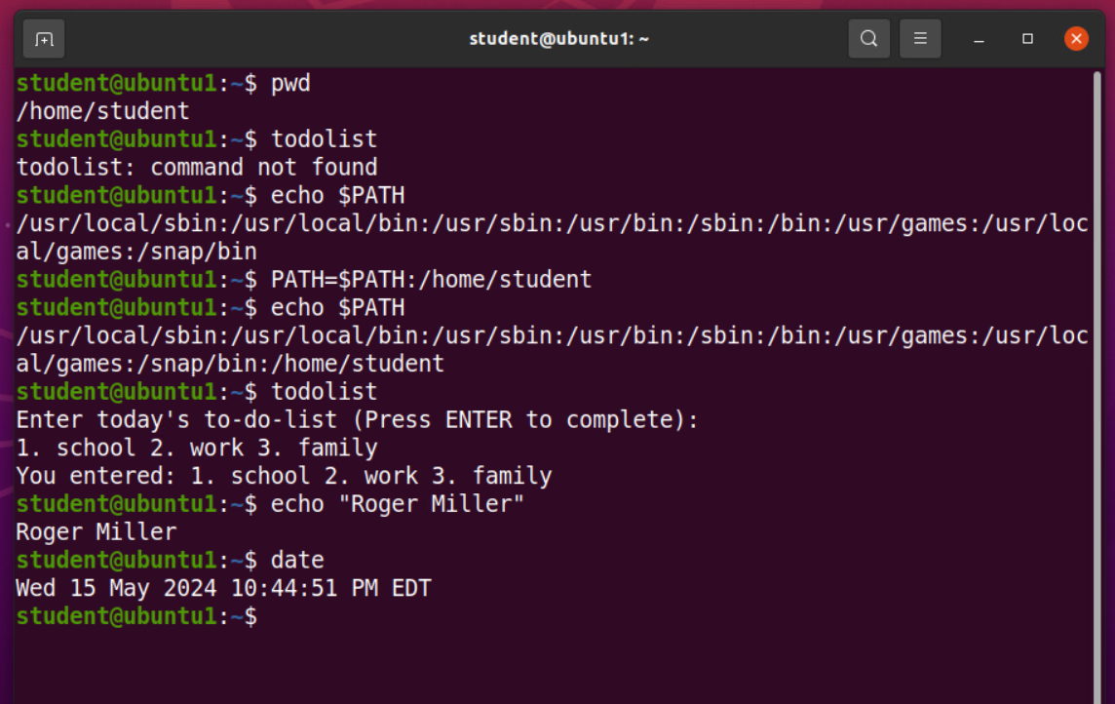
Set the PATH variable

Slide 14
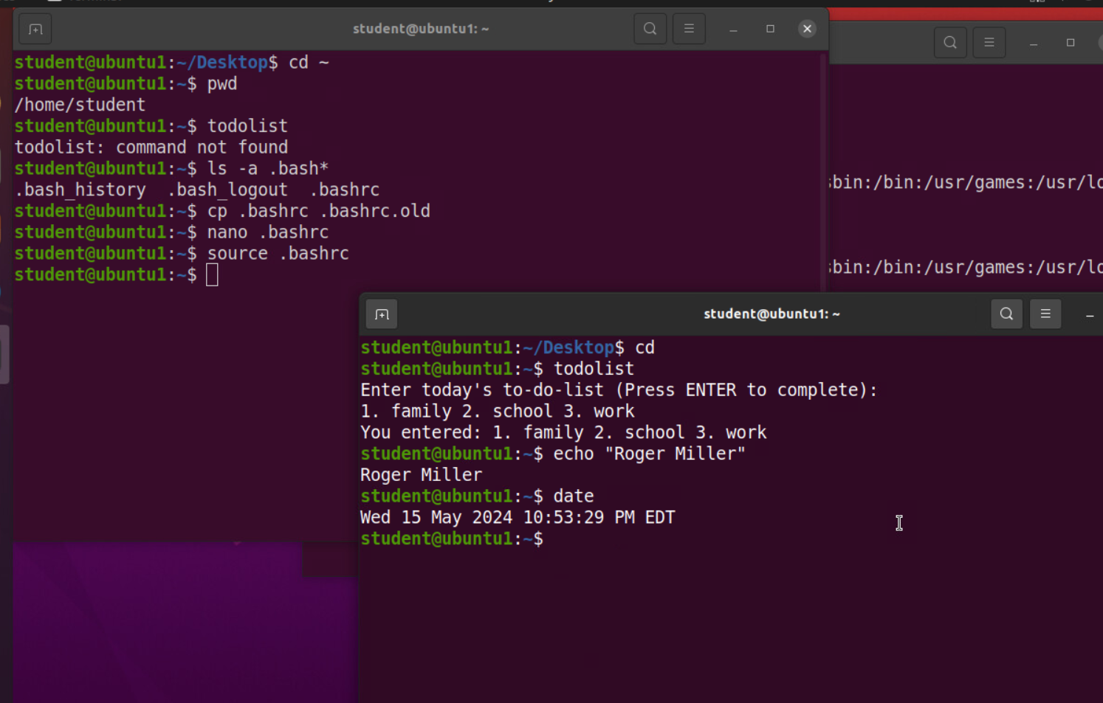
Make the PATH variable permanent

Slide 15
Course Project
Operating Systems
Module 4 User and Group Management

Slide 16
Rubric
Activity
Add users and groups in CLI
Test user and group settings
Add users in GUI
Remove users and groups

Slide 17
Add users and groups in CLI
1. What does the –m option in the useradd command do?
Answer here:
-m – tells useradd command to create home directory for this new user
2. What does the -3 option in the tail command do?
Answer here:
-3 – tells tail command how many lines to show from the end of the file
3. Which line of the /etc/group file lists members of the “students” group? Copy it here.
Answer here:

Slide 18
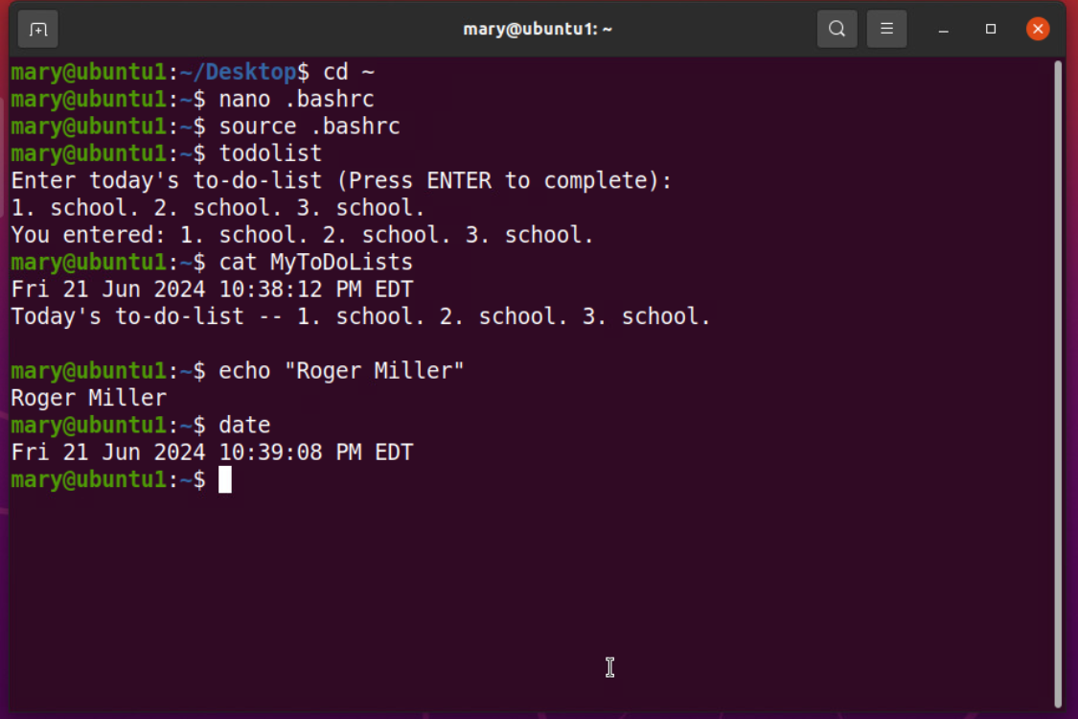
Test user and group settings

Slide 19
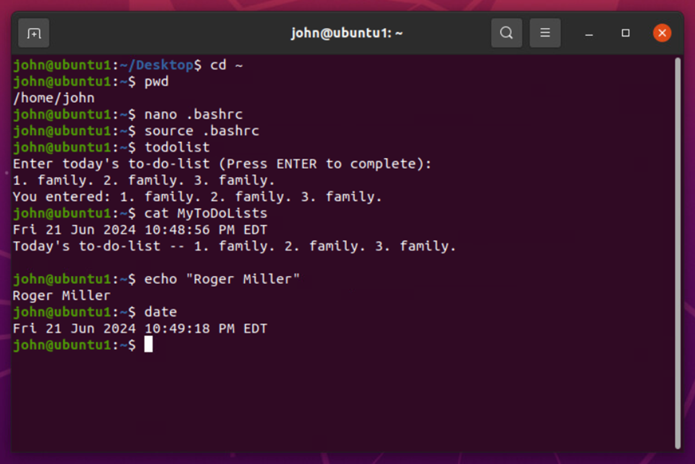
Add users in GUI

Slide 20
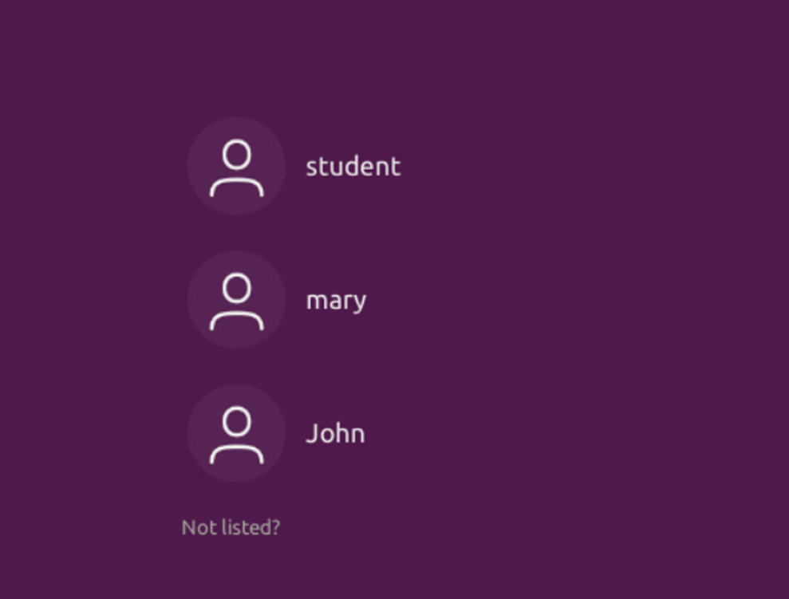

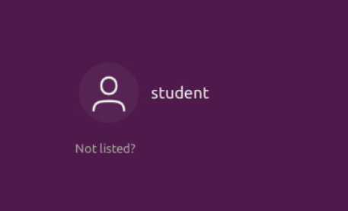
Remove users and groups

Slide 21
Course Project
Operating Systems
Module 5 Network Configuration

Slide 22
Rubric
Activity
Discover host IP configurations
Manage network interfaces
User network utilities

Slide 23
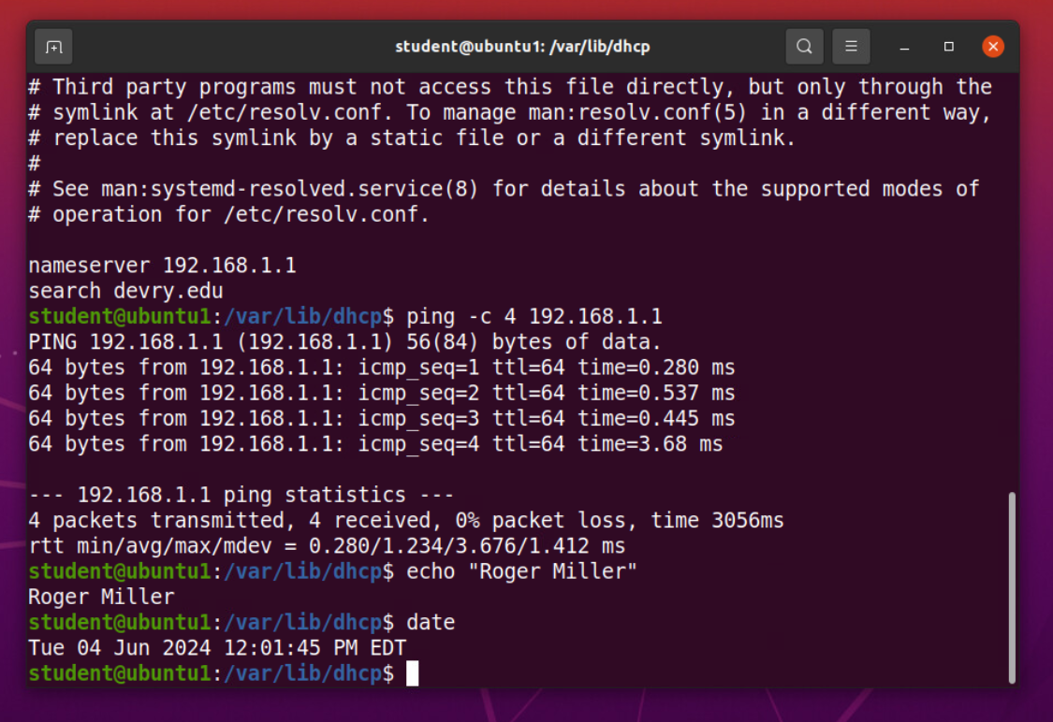
Discover host IP configurations
1. What is the IP address of your Ubuntu machine?
Answer here: 192.168.1.108
2. What is the IP address of its default gateway?
Answer here: 192.168.1.1
3. What is the IP address of its DHCP server?
Answer here: 192.168.1.1
4. What is the IP address of its DNS server?
Answer here: 192.168.1.1

Slide 24
Manage network interfaces
Which DHCP message is shown in the output of the sudo dhclient –v –r eth0 command?
Answer here: DHCPREALSE
2. Which four DHCP messages are shown in the output of the sudo dhclient –v eth0 command?
Answer here:
DHCPDISCOVER
DHCPOFFER
DHCPREQUEST
DCHPPACK

Slide 25
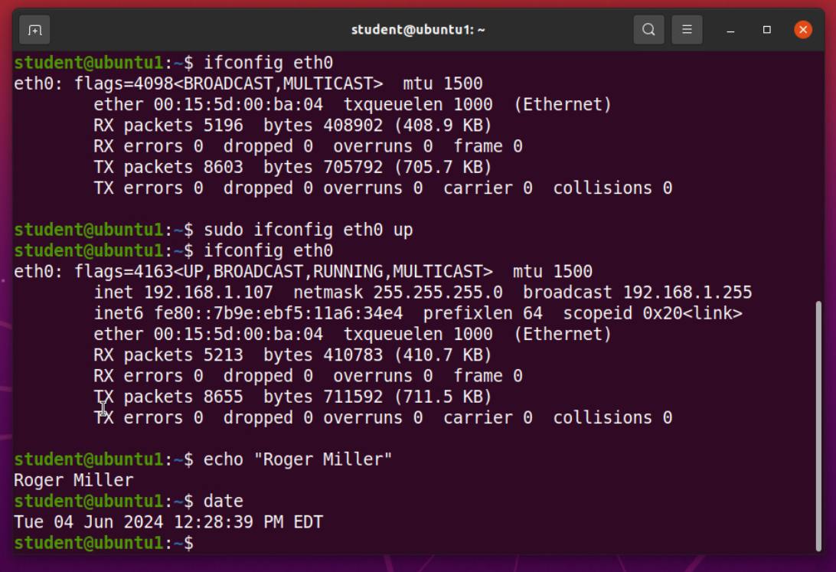
Use network utilities

Slide 26
Course Project
Operating Systems
Module 6 System Performance Monitoring

Slide 27
Rubric
Activity
Monitor processes
Monitor user activities
Monitor network bandwidth usage

Slide 28
Monitor Linux processes
1. What is the default action of the 15 SIGTERM kill signal?
Answer here: kill the highlighted process
2. In the System Monitor window, click on % CPU to sort the processes by CPU load. Which process shows the highest percentage of CPU usage?
Answer here: gnome-shell (GUI)

Slide 29
Monitor user activities
Issue the sudo accton on command to turn on GNC accounting. Run the sudo updatedb command. Enter lastcomm updatedb to check if the updatedb command was executed before. Remember to turn off GNC accounting (sudo accton off) after answering the questions.
1. What flag value is displayed in the output?
Answer here: $ -- “super user”
2. Why is the name of the user who ran the processes shown as root, not student?
Answer here: superuser

Slide 30
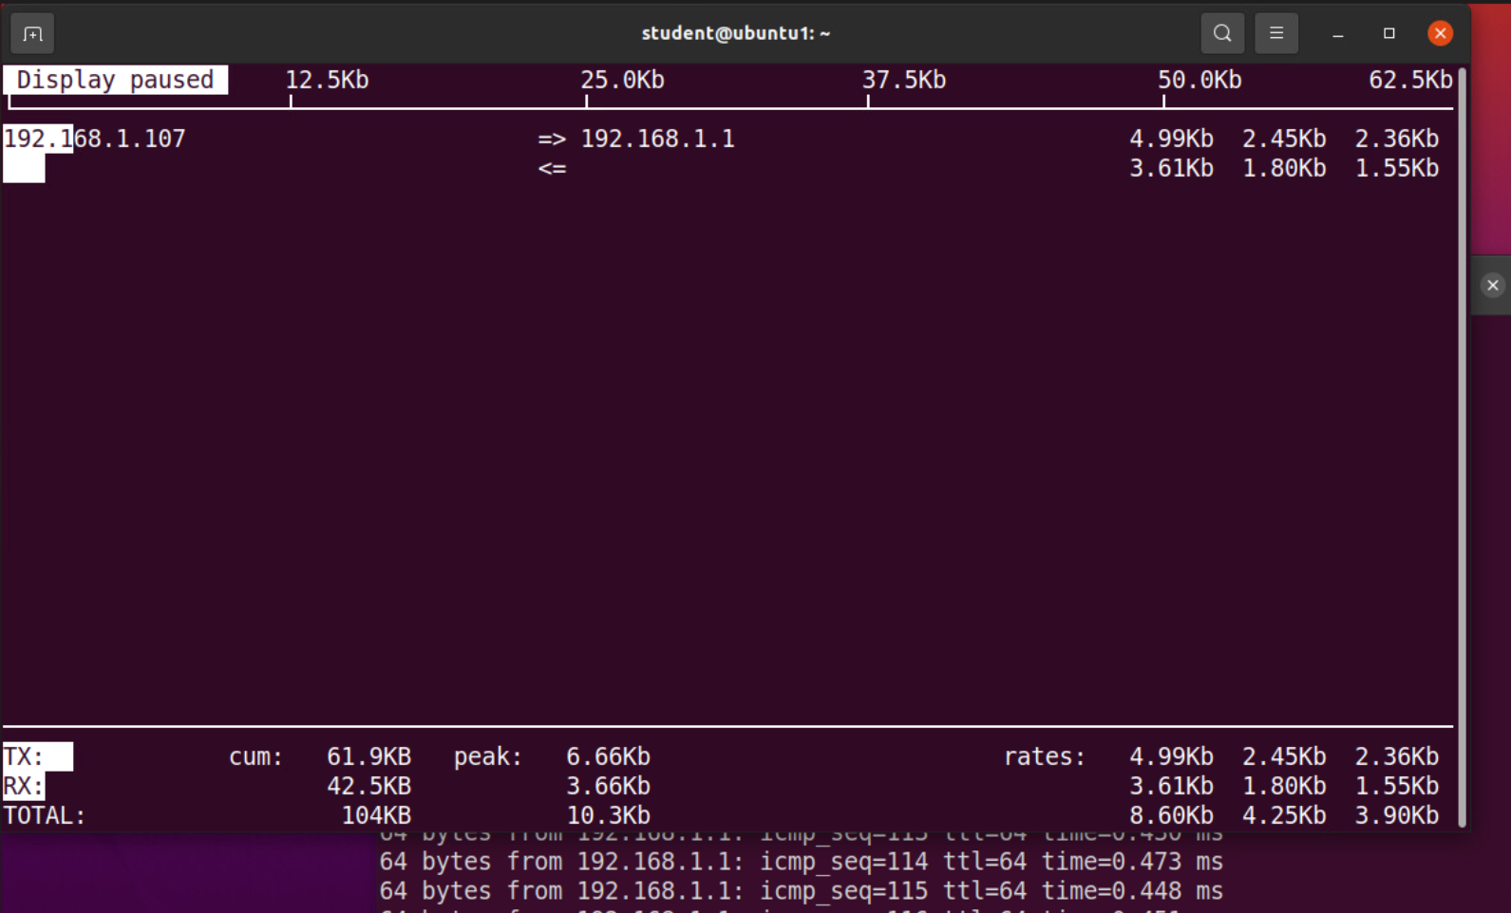
Monitor network bandwidth usage

Slide 31
Challenges
Challenges Faced:
Initial difficulties in navigating the virtualized environment.
Troubleshooting issues with network configurations.
Managing user permissions and access control effectively.
Overcoming Challenges:
Addressing problems step-by-step.
Utilizing online resources and seeking assistance from peers and instructors.

Slide 32
Skills Acquired:
Proficiency in Linux OS navigation and administration.
Ability to write and manage shell scripts.
Expertise in network configuration and system performance monitoring.
Improved problem-solving and troubleshooting skills.
Enhanced written and oral communication skills through project documentation and presentation.

Slide 33
Summary
This project provided hands-on experience with Linux OS in a virtualized environment.
Reinforced essential IT skills and prepared for future challenges in the field of Information Technology.
The skills and knowledge gained will be invaluable in pursuing a career in IT and networking.

