Slide 1
SEC285: Fundamentals of Information System Security
Module Deliverable Summary - Week 8
Roger Miller
October 2024

Slide 2
Table of Contents
Introduction
Multifactor Authentication (MFA) Setup
Port Reduction via Firewall
System Development Using Technological Principles
Encryption and Decryption Using PGP
Demonstrating Communication Skills – BYOD Security Policy
System Testing and Experimentation Using Nmap and NetCat
System Testing and Experimentation Using Nessus and WireShark
Conclusion

Slide 3
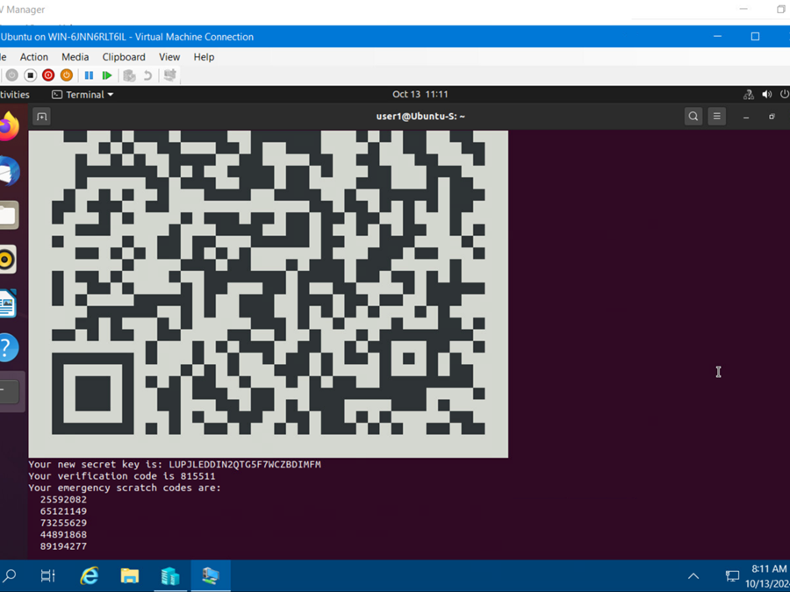
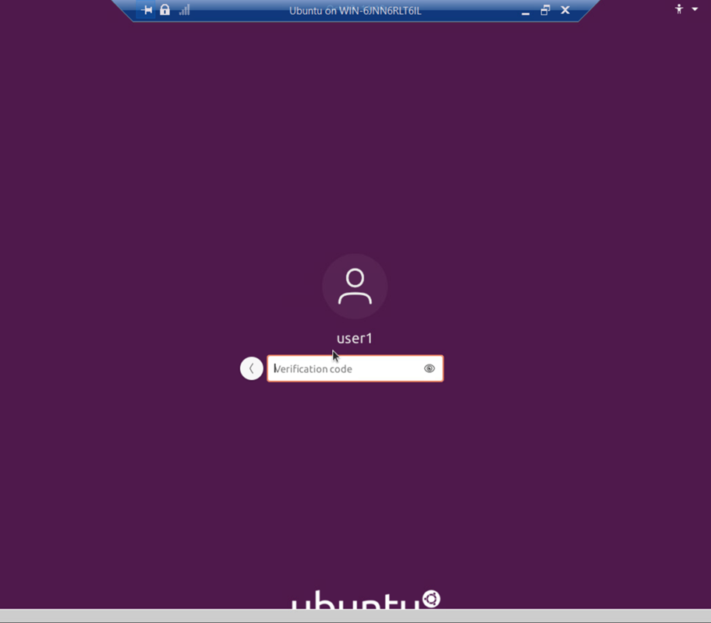
Multifactor Authentication (MFA) Setup
Learning Outcome: Evaluate alternative solutions to problems
- Configured MFA using the Google Authenticator module.
- Successfully tested the MFA logon screen with verification code requirements.
- Screenshots included: Common-auth Configuration File, MFA Logon Screen.
Common-auth Configuration File
MFA Logon Screen

Slide 4
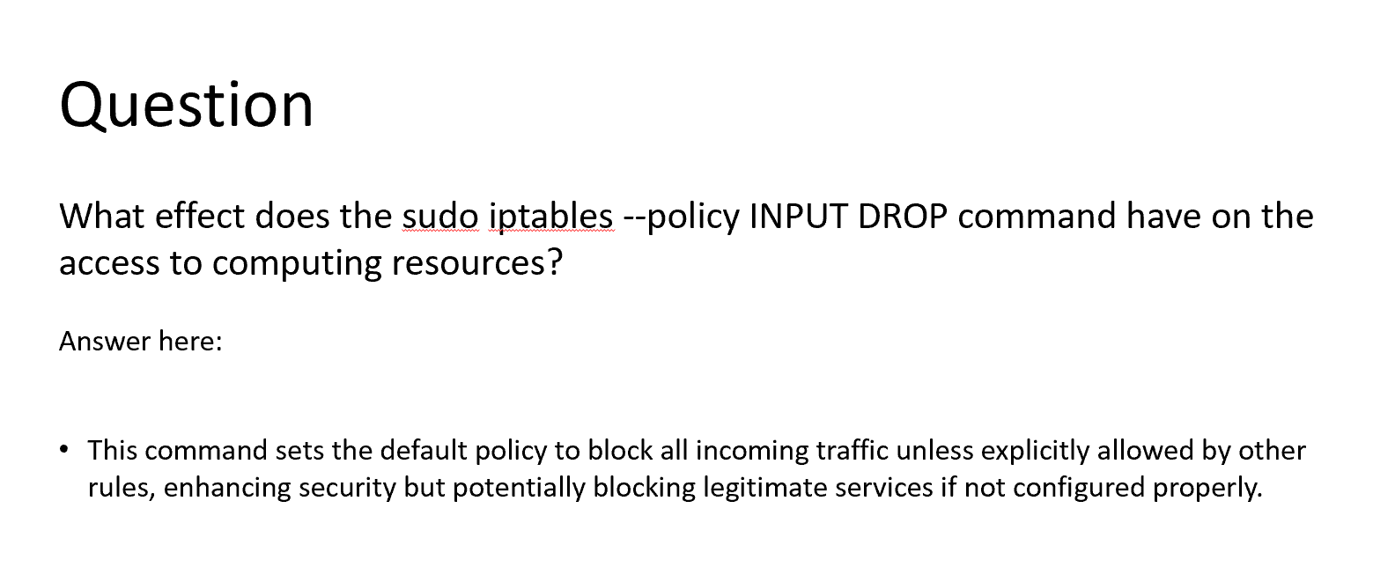
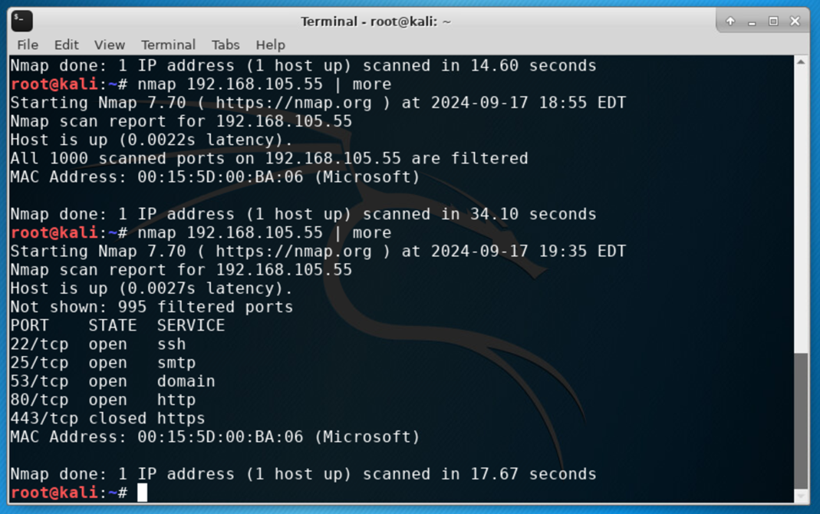
Port Reduction via Firewall
Learning Outcome: Analyze problems using methods, software, or equipment
- Used Nmap to scan and assess open ports.
- Implemented firewall rules to reduce open ports to five.
- Screenshot included: Nmap scan results.
Nmap Scan

Slide 5
System Development Using Technological Principles
Learning Outcome: Develop a System Utilizing Technological Principles
- Successfully constructed the project system without errors.
- Employed tools such as Kali Linux and configuration scripts.
What impact does the command 'sudo iptables --policy INPUT DROP' have on access to computing resources?
Response:
This command establishes the default policy to block all incoming traffic unless explicitly permitted by other rules, thereby enhancing security while potentially obstructing legitimate services if not appropriately configured.
Nmap Scan Results for Firewall Assessment

Slide 6
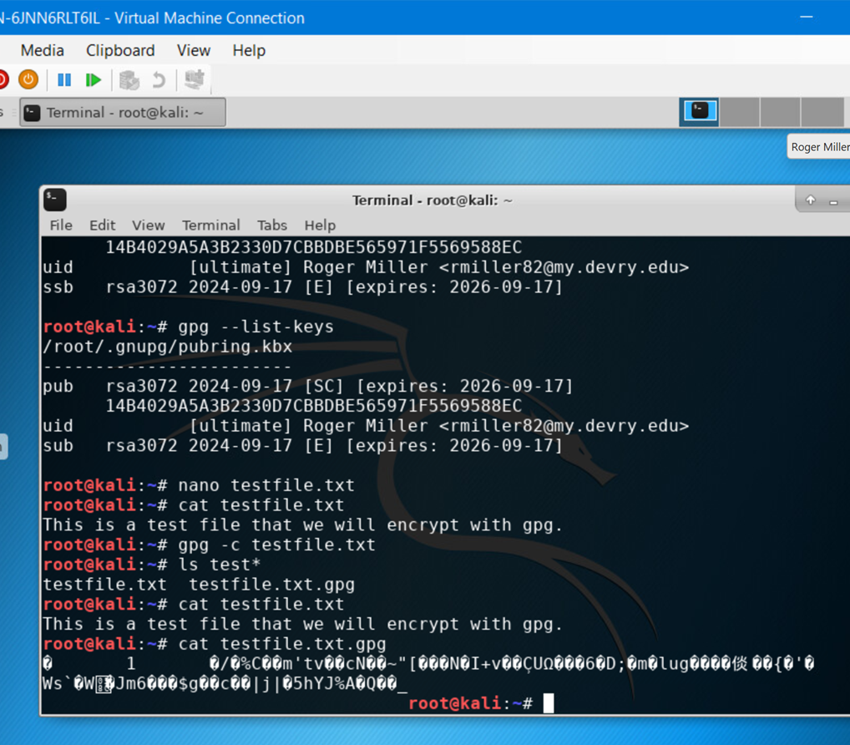
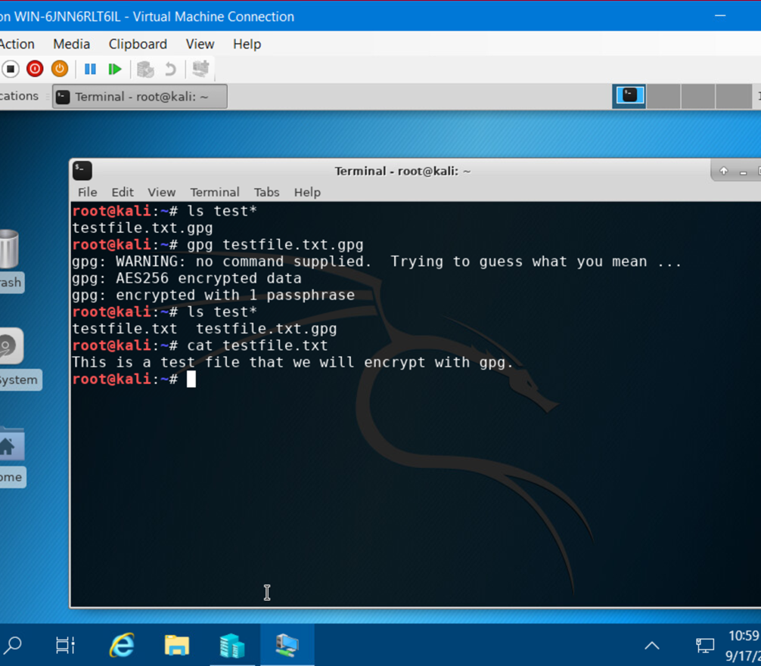
Encryption and Decryption Using PGP
Learning Outcome: Identify unknown problems using mathematical and scientific methods
- Performed both encryption and decryption using PGP.
- Screenshots included: File Encryption, File Decryption.
- Demonstrated secure data handling and cryptographic methods.
File Encryption
File Decryption

Slide 7

Demonstrating Communication Skills – BYOD Security Policy
Learning Outcome: Operate a system based on technology principles
Communicated policy requirements clearly to ensure accessibility for employees and other stakeholders.
Addressed device compliance, security, and access control.
Guaranteed compliance with HIPAA and PCI-DSS.
Click the image to view the complete BYOD policy document.

Slide 8
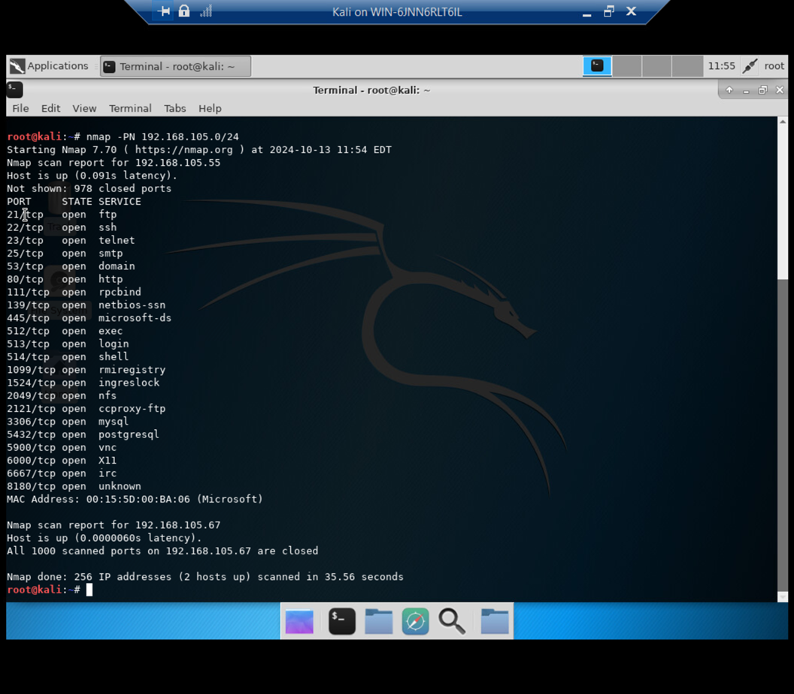
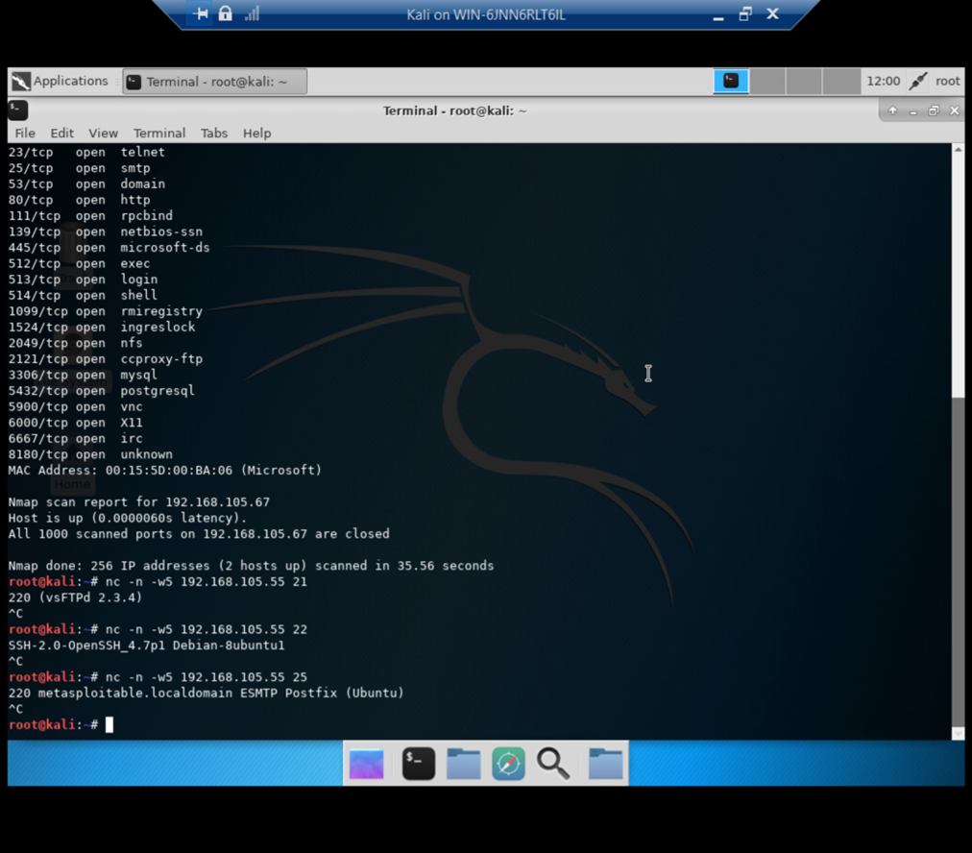
System Testing and Experimentation
Learning Outcome: Perform system tests and experimentation
- Used Nmap and NetCat for vulnerability assessment.
- Screenshots included: Results from two tools.
- Identified system vulnerabilities and proposed mitigations.
Nmap
NetCat

Slide 9
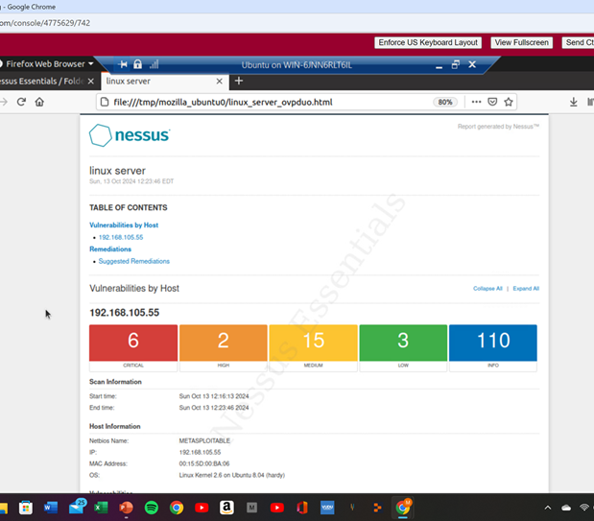
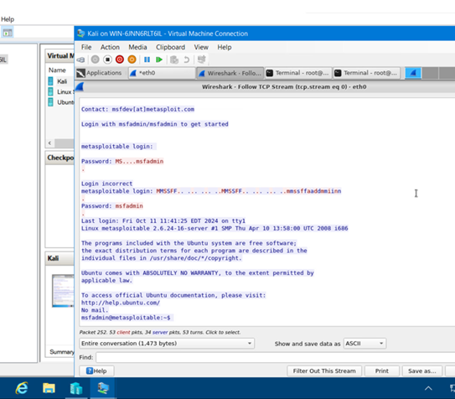
System Testing and Experimentation
Learning Outcome: Perform system tests and experimentation
- Used Nessus and Wireshark for vulnerability assessment.
- Screenshots included: Results from two tools.
- Nessus scan used to identify and categorize potential vulnerabilities post-integration.
Nessus
Wireshark

Slide 10
Conclusion
Summary of Key Activities
Configured MFA and tested it successfully.
Reduced open ports via firewall (Nmap).
Created a BYOD Security Policy.
Completed PGP encryption and decryption.
Conducted vulnerability assessments (Nmap, NetCat, Nessus, Wireshark).
Knowledge and Skills Gained
Throughout this project, I developed a deeper understanding of essential security principles, including data protection, access control, and vulnerability management. I enhanced my technical skills by configuring security tools and implementing security measures effectively. Additionally, creating and presenting security documentation helped strengthen my communication skills, enabling me to convey complex information clearly and professionally.
Reflection
This project provided hands-on experience in cybersecurity, building my confidence in applying security practices to real-world situations.

